Slide 1

EOSC FAIR Working Group: from FAIR principles to FAIR practices
Oya Beyan
Fraunhofer FIT
RDA Deutschland Tagung 2020, 27.02.2020, Potsdam

Slide 2
Why the EOSC?
  Enable Open Science and the digital transformation of science
  Empower 1.7 million European researchers to reap the benefits of data-driven science
  Build an open research data commons in Europe widely inclusive of all disciplines and Member States, sustainable in the long-term
  Give Europe a global lead in research data management;
  help developing an internet of FAIR digital objects
  Reduce fragmentation by federating existing Research Infrastructures (including e-Infrastructures)
  Enable interdisciplinary research to address societal challenges
  Enable the Digital Single Market and stimulate the emergence of a competitive EU cloud sector
Notes:
Data and information is the foundation of our knowledge.
We want to faster development on science by making data open, FAIR
This digital transformation will empower data driven science,
will give Europe a global lead in research data management
And enable interdisciplinary research

Slide 3
What is the EOSC?
  A trusted and open virtual environment for the scientific community with seamless access to services (with highest TRLs) addressing the whole research data life cycle:
    Federating core services to federate and connect existing or planned RIs
    Services to make data FAIR, store them, ensure their long-term preservation
    Services to find, access, combine, analyse and process data
    Protected, personalized work environment
  FAIR competition, no lock-in by individual service providers
  Free at the point of use for the researchers
  User-oriented and inclusive (across borders and disciplines)
  Accessible through a non-exclusive, simple, universal gateway
  Governed by a minimal set of Rules of Participation
  Steered by a governance based on increasing mutuality
Notes:
EOSC is a federated data infrastructure for scientific community
It creates a trusted and open environment to host data and services
Core services connects RI
Provide services to make data FAIR, sustain it in a long term and reuse it by accessing and analyzing it

Slide 4

An open festival for science
Virtual space where science producers and science consumers come together
Inclusive to people of all backgrounds and cultures
An open-ended range of content and services
Be a living, breathing system that adapts to changes
A platform for European research
Notes:
A virtual market where science produces and consumers come together
Inclusive
And a living system adapting to changes

Slide 5
Design principles
bit
Co-creation
Research-led
Community-driven
Flexible by design
Extensible / scalable
Incremental and iterative
Hands-on and participatory
Continuous engagement, consultation & user testing
by
bit
Notes:
Focused on researchers needs, community driven
Developed incrementally and iteratively
With a continuous engagement

Slide 6
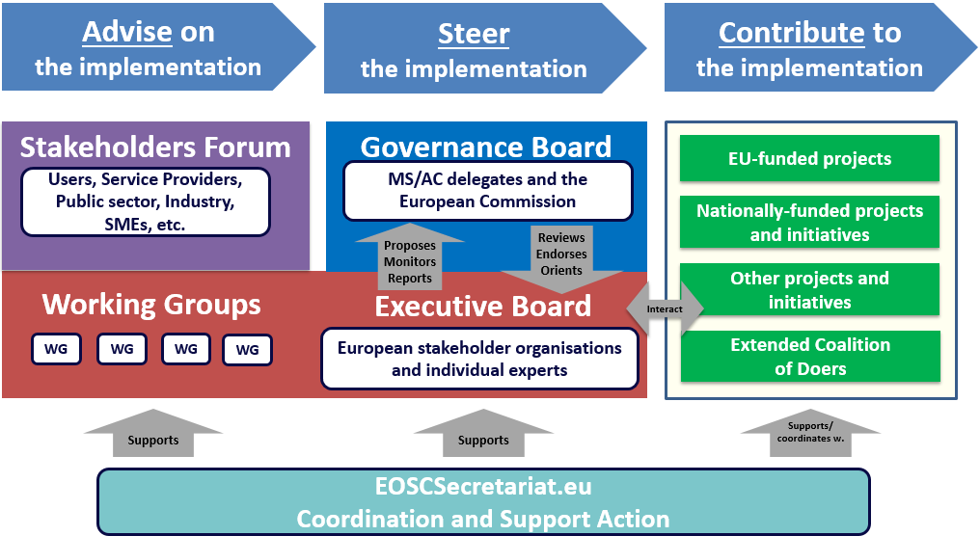
EOSC governance structure
Notes:
For the period 2019-2020, the EOSC governance is organized with a Governance Board, an Executive Board, and a Stakeholders Forum.
• The Governance Board is composed of representatives from Member and Associate States. It is chaired by representatives from the European Commission.
• The Executive Board is composed of 11 members which have been chosen following a call for applications the results of which have been published on 23 November 2019 .
• The Stakeholders Forum will comprise users, EU-level and national projects, service providers, public sector, SMEs, Industry, etc
• Five Working Groups will be created during the second quarter of 2019 in order to coordinate progress on the priorities chosen by the Governance Board after proposal from the Executive Board. They will be composed of representatives from the EOSC stakeholders. More Working Groups will be created as new priorities emerge.

Slide 7
Governance Board
Representatives from all 28 member states and 10 associated countries
Chaired by Hans Josef Linkens, BMBF, Germany
Forming sub-groups to feed strategic inputs into EOSC Exec Board and Working Groups
https://ec.europa.eu/research/openscience/pdf/ec_rtd_eosc-governance-board_062019.pdf
Notes:
Federal Ministry of Education and Research (BMBF)

Slide 8
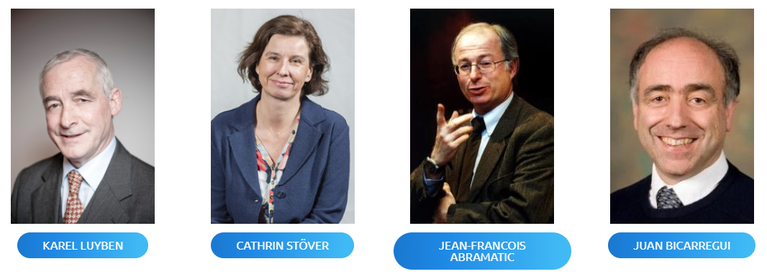
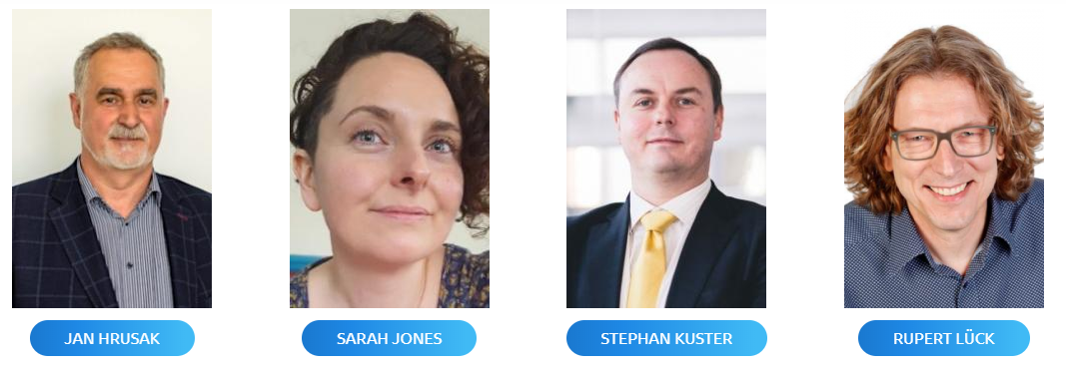
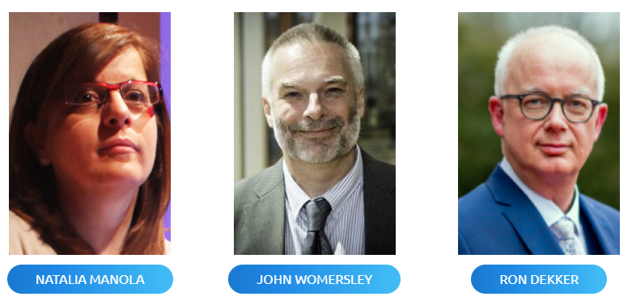
Executive Board
Karel Luyben & Cathrin Stöver as Co-Chairs
8 representatives of stakeholder groups
3 independent experts
https://www.eoscsecretariat.eu/eosc-governance/eosc-executive-board

Slide 9
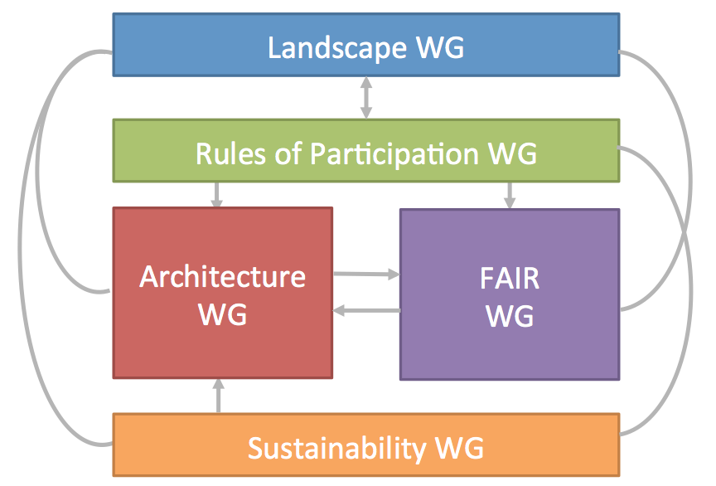
EOSC Executive Board WGs
https://www.eoscsecretariat.eu/eosc-working-groups
Notes:
5 wg is established reflecting EOSC priorities for federating data and services.
. Landscape: Mapping of the existing research infrastructures which are candidates to be part of the EOSC federation;
• FAIR: Implementing the FAIR data principles by defining the corresponding requirements for the development of EOSC services, in order to foster cross-disciplinary interoperability;
• Architecture: Defining the technical framework required to enable and sustain an evolving EOSC federation of systems;
• Rules of Participation: Designing the Rules of Participation that shall define the rights, obligations governing EOSC transactions between EOSC users, providers and operators;
• Sustainability: Providing a set of recommendations concerning the implementation of an operational, scalable and sustainable EOSC federation after 2020.

Slide 10
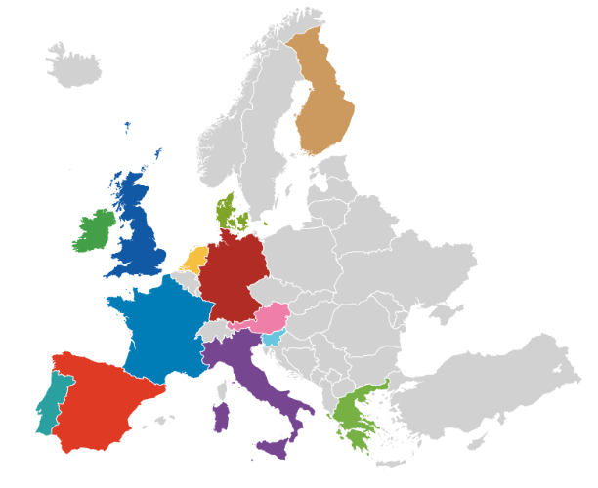

WGs by numbers
Experts represent 20 of the EU Member States and Associated Countries
Landscape
11 male
5 female
RoP
5 male
7 female
Architecture
13 male
1 female
FAIR
15 male
11 female
Sustainability
9 male
6 female
Notes:
WG members are nominated by governance and executive board, as well as related H2020 projects.
Additionally : Open calls to engage wider stakeholders (Architecture, FAIR and Rules of Participation)

Slide 11
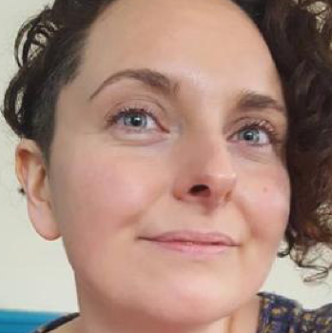


Chair: Sarah Jones
Independent Expert
WHAT
WHY
Provide recommendations on the implementation of FAIR, including corresponding requirements for services, in order to foster cross-disciplinary interoperability
Connect people, data and service via standards
Be the glue
HOW
Data standards & sharing agreements
Upscale best-practice solutions
EOSC Interoperability Framework
Identify service requirements for FAIR
Persistent Identifier Policy for EOSC
Frameworks to assess FAIR data and certify services that enable FAIR
Converge towards globally-accepted frameworks
Q2 2019
2019 Annual FAIR work plan
Q4 2019
PID policy defined
Outline metrics for FAIR data & service certification
Q1 2020
2020 Annual FAIR work plan
Q3 2020
EOSC Interoperability Framework
Q4 2020
Updated PID policy
Updated FAIR metrics & service certification
testing & iterating
Notes:
Provide recommendations on how to implement FAIR practices in the EOSC
Aim is to achieve cross disciplinary interoperability
The implementation of FAIR and Open Science policy requires a culture change supported by appropriate incentives and coherent, easy-to-use data services
The FAIR & Architecture WGs will operate in close alignment
FAIR WG; gather requirements relevant to the EOSC services
addresses cultural aspects such as semantic and legal interoperability, certification and community data standards,
Architecture: focus on the related technical specifications that address FAIR requirements.
The EOSC-FAIR working group will define a FAIR work plan:
to set out the actions needed to develop EOSC shared resources and define the operational guidance and
methodologies for applying the FAIR principles with these shared resources, including through FAIR maturity models and FAIR accreditation/certification schemes
The outcome of the action plan would eventually constitute a new operational framework for FAIR research data.

Slide 12

FAIR Expert Group Recommendations
Cultural Change
Incentives & Metrics
Skills & Capacity Building
Supporting Services
Notes:
Describes broad range of changes required for implementation of FAIR principles

Slide 13
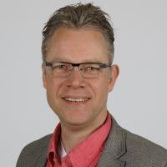
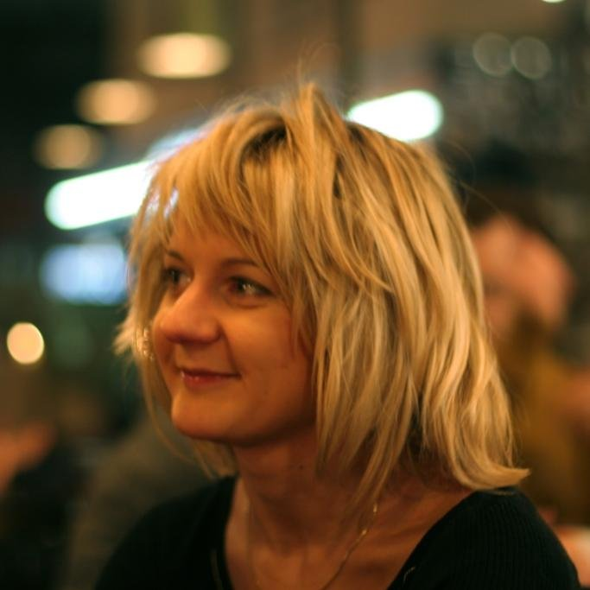
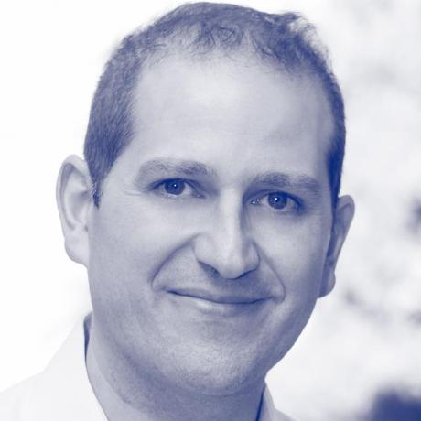
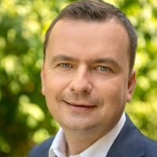


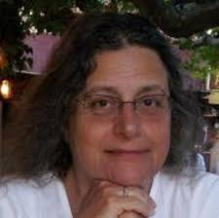

FAIR WG task forces (and leaders)
Dynamic duo
Rob Hooft
Marta Teperek
Semantic specialists
Oscar Corcho
Krzys Kurowski
FAIR practice
Interoperability
PID policy
Metrics & certification
Identifier nerds
Peter Wittenburg
Rachael Kotarski
Research leads
Francoise Genova
Magnus Aronsen
Notes:
FAIR practice
Reviewing existing studies on FAIR practice in disciplines
Have established good working relations with FAIRsFAIR
Developing a continuously updated deliverable (report, matrix, index) of FAIR practice
Plan to consult community on best format for reuse in other work
PID policy
Reviewing PID policies & recommendations
Identified a few discussion topics to review per call
Define coverage of what entities need to be persistent
Consider other approaches e.g. URIs
Address data labs aspect, not just published content
Interoperability
Fleshing out definitions & questions on interoperability:
Semantic
Technical
Legal
Organisational
Considering levels of interoperability. Basic minimum +
Metrics & certification
Liaising with RDA WG on FAIR maturity metrics
Working with FAIRsFAIR on repository certification
Considering what to certify beyond repositories
Metadata and vocabulary registries
PID services
Others…

Slide 14

FAIR as a Process
EOSC FAIR WG provides Recommendations on:
1. Data standards and sharing agreements
2. Best practices adoptable at the multi-disciplinary levels
3. An EOSC Interoperability Framework:
interoperable-by-design
4. Service requirements
5. PID Policy for EOSC
6. Frameworks to assess FAIR data
and certify services that enable FAIR
7. Converge towards globally-accepted frameworks
Notes:
The WG will provide recommendations on:
1. The development and adoption of data standards and sharing agreements
2. Best practices that are already applied in specific scientific domains or countries and can be adopted at the multi-disciplinary and European levels
3. An EOSC Interoperability Framework that overarches disciplinary approaches and encourages research infrastructures to be interoperable-by-design
4. Service requirements for FAIR implementation, relevant to the Architecture WG
5. A Persistent Identifier (PID) policy for the EOSC
6. Frameworks to assess FAIR data and certify services that enable FAIR, including the collation of results e.g. catalogues of certified repositories
7. The international dimension of FAIR principles, converging towards globally-accepted frameworks

Slide 15

Inclusiveness:
Taking diversity into account
communities may be at very different stage
be aware of community needs and practices
adaptation of legacy data sharing systems
FAIR
FAIR
FAIR
FAIR
FAIR

Slide 16
Cross Domain Usage
new potential users share less of the context
Requires a generic interpretation of data
more efforts !
Interoperability
Unforeseen reuse of data
Cost of FAIRification

Slide 17


Convergence
Cross domain usage without causing an unintended impact on hindering existing good data sharing practices within communities
Cross
Disciplinary

Slide 18





Incentives and Metrics
How to incentivize
FAIR Data
Producers Beneficiaries

Slide 19



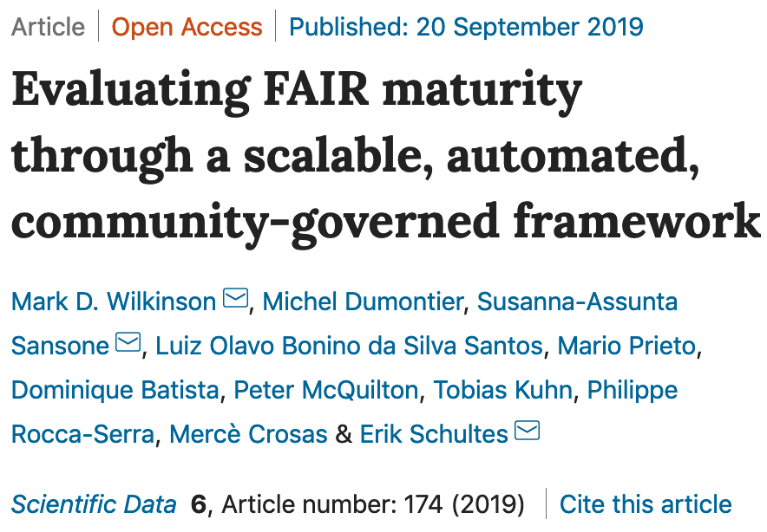
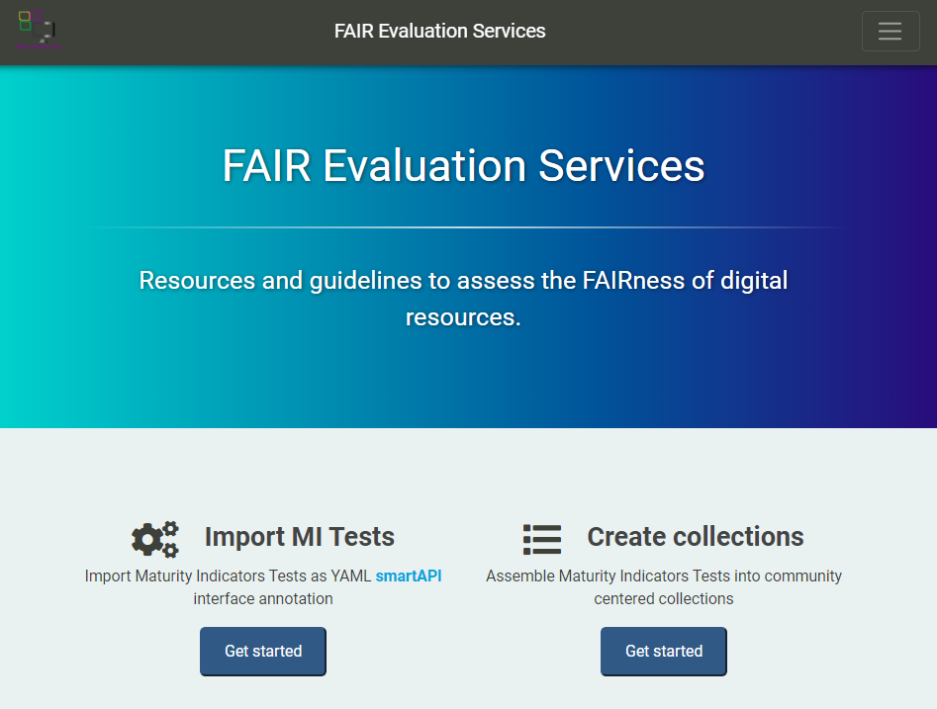
Evaluation methods
Community initiatives:
FAIR Data Maturity Model WG
https://w3id.org/AmIFAIR
19
Notes:
Metrics are important to measure
Understand the current state and progress

Slide 20

Granularities of FAIR
Search for experiments contain transcriptomics assays for 'Prostate Cancer' | Search for experiments comparing gene expression in mouse pancreas and prostate | Integrate NGS-RNAseq data with cell Imaging studies | search for transcriptomic data generated from the same platform applied to samples from a specific tissue from animals that have a specific genotype | find the study design and methodology

Slide 21
Evaluation methods: allow inclusiveness and scalability
multi-step maturity scales to measure the FAIRness
FAIRness as a continuum allows for progress
Community progress measured over time
High level metadata, reuse requires manual work
Machine Actionable, Interoperable, Cross Domain Reuse

Slide 22

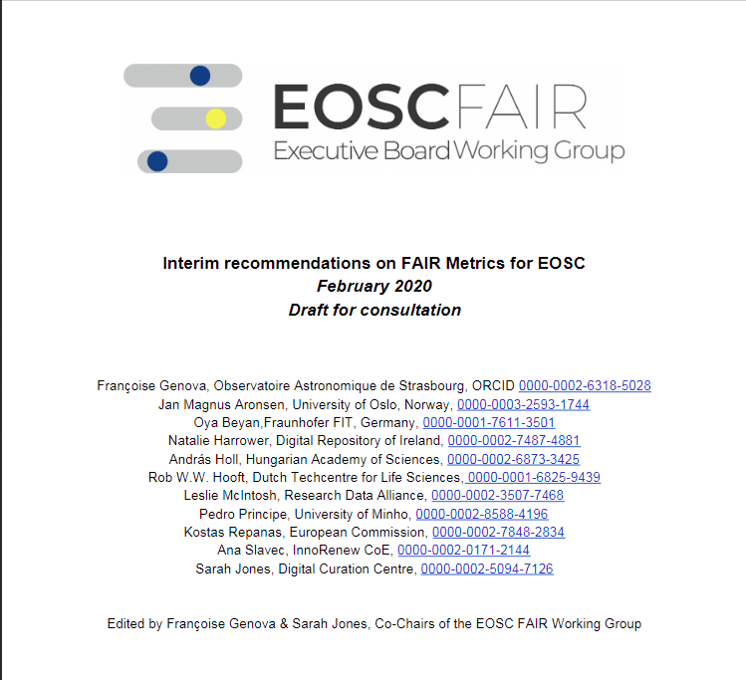

https://www.eoscsecretariat.eu/eosc-liaison-platform/post/interim-recommendations-fair-metrics-and-service-certification-apply

Slide 23
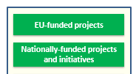

Co-creation
reach out to H2020 projects, national initiatives and coalition of the doers
Working Groups dependent on YOU!
You building and we coordinate & endorse
Collectively we will build EOSC
Funding : https://www.eoscsecretariat.eu/funding-opportunities
Interact

Slide 24

Thanks for listening!
Questions?

