Slide 1

FAIR Data Maturity Model designed by the scientific community The last mile before launch presented by Edit Herczog RDA Council, and FAIR Maturity Model WG Co chair
RDA-DE conference
26th of February 2020

Slide 2

FAIR as part of the solutions for the challenges a head in the EU

Slide 3

The (very) short history of FAIR
2012:
Force 11: The abreviation FAIR agreed
2016: The EU HLGR on Open Science
FAIR principals arrive to top policy level
2018: FAIR Maturity Model WG
Already 11 FAIR evaluation methods exist
Half of RDA WGs work on different aspects of FAIR
2018: FAIR is in the Horizon Europe Program Proposal
2021: FAIR is in the Horizon Europe Work Programs
RISK: Without common understanding the criteria and guidelines FAIR will turn to be a hype instead of long term added value for all

Slide 4
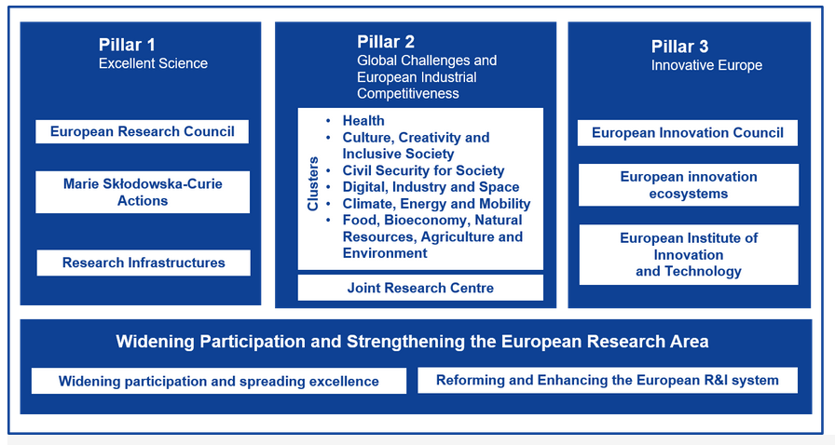
The Horizon Europe Programme 2021-27 Resource are allocated to the pillars
The Global challenges are all interdomain where FAIR criteria can be a big help

Slide 5

The SDGs: CROSS DOMAIN CHALLENGE
The SDGs implementation: Minimum three goals should be interconnected

Slide 6
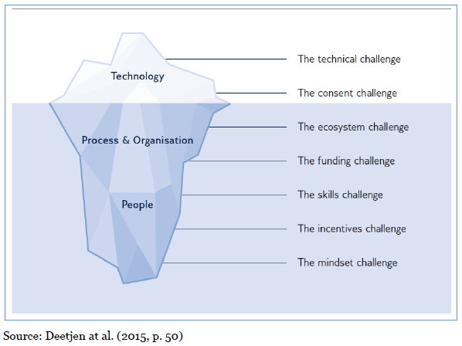
The iceberg is slowly melting

Slide 7
HOW TO BE FAIR: From FAIR PRINCIPALS TO FAIR MATURITY MODEL CRITERIA

Slide 8
Who we are
WG started the WG in January 2019
First plenary session at P13 in Philadelphia
Co chairs:
Keith Russel from Australia
Edit Herczog from Europe
Shelley Stall from USA
Technical Advisory Boards (TAB) member:
Jane Wyngaard from South Africa
Secretariat: Yolanda Meleco from USA
Editorial team: EC special support
Makx Dekkers and the PWC team
129 members: 61 Female, 68 male
We aim to keep the WG 18 months timeline: It would allow to use our recommendation in 2021

Slide 9

Scope: WHAT not the HOW
BUT the Working Group does NOT have the purpose to ...
develop yet-another-evaluation-method: the core criteria are intended to provide a common ‘language’ across evaluation approaches, not to be applied directly to datasets.
define how the core criteria need to be evaluated. The exact way to evaluate data based on the core criteria is up to the owners of the evaluation approaches, taking into account the requirements of their community
revise and re-design the FAIR principles

Slide 10
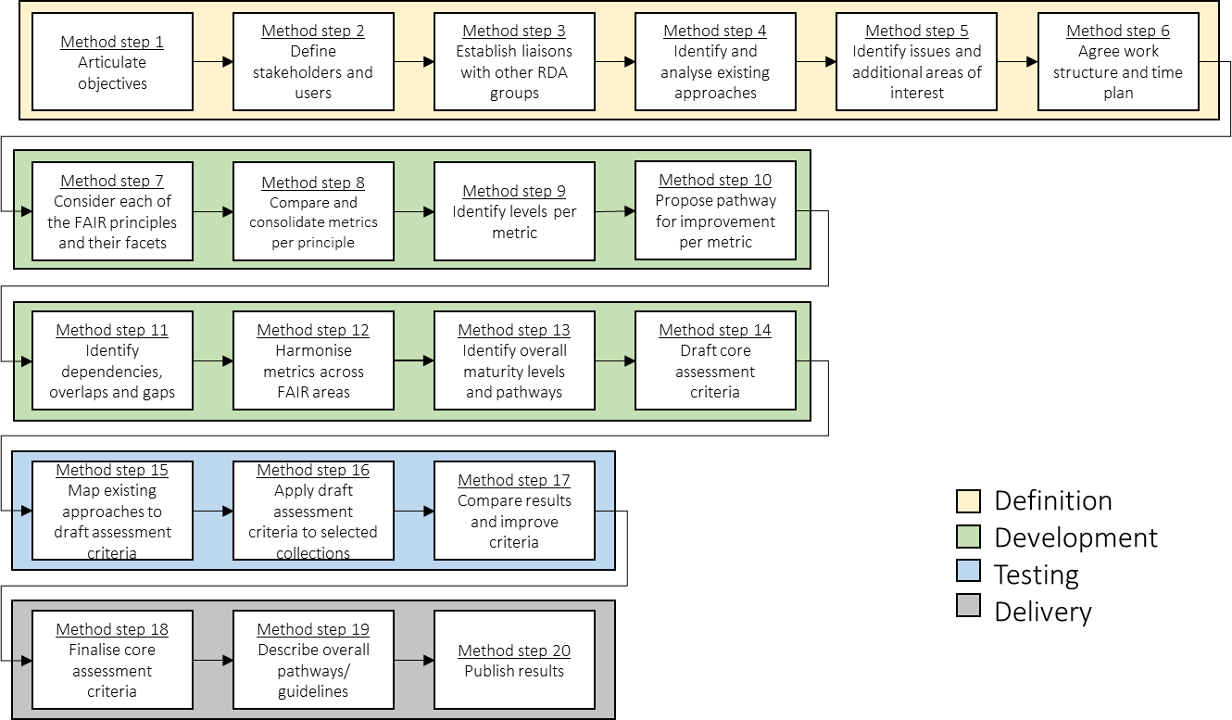
Overview of the methodology
Notes:
Objective: give an impression of the steps we will take, but not discuss in detail every step (the audience can read this afterwards).

Slide 11
Part I.
Definiton
Proposed Scope

Slide 12
Analyse the methods + Survay
So far, 11 approaches are on the radar
 | Approaches considered
 | ANDS-NECTAR-RDS-FAIR data assessment tool DANS-Fairdat DANS-FAIR enough? The CSIRO 5-star Data Rating Tool FAIR Metrics questionnaire Checklist for Evaluation of Dataset Fitness for Use RDA-SHARC Evaluation FAIR evaluator
 | Approach partially considered*
 | Data Stewardship Wizard
 | Approaches not considered*
 | Big Data Readiness Support Your data: A Research Data Management Guide for Researchers
123 questions
Over and underused
5 types of option
Yes/no, Free text
4 scoring approaches
Stars, grades, loading bar,
+ SURVEY,

Slide 13
Summary: Proposed scope
 | Proposed resolutions
ENTITY | Dataset and data-related aspects (e.g. algorithms, tools and workflows)
NATURE | Generic assessment (i.e. cross-disciplines)
FORMAT | Manual assessment
TIME | Periodically throughout the lifecycle of the data
RESPONDENT | People with data literacy (e.g. researchers, data librarians, data stewards)
AUDIENCE | Researchers, data stewards, data professionals, data service owners, organisations involved in research data and policy makers
Notes:
During the previous worskshop, these questions came up regarding the scope. The editorial team created github threats to discuss, through no input was received. Therefore, we propose the following resolutions (in line with the case statement).

Slide 14
Part II.
Development
Proposed criteria

Slide 15
Development | Statistics
More concrete contribution for F & A
Most contribution are about metadata
Complex versus simple principles [e.g. 11 indicators for F1 compared to 1 indicator for I3]

Slide 16
Overview | Indicators & levels
Under discussion
Provisionally agreed
F |  | F1 (Meta)data are assigned globally unique and persistent identifiers
 |  | F2 Data are described with rich metadata
 |  | F3 Metadata clearly and explicitly include the identifier of the data they describe
 |  | F4 (Meta)data are registered or indexed in a searchable resource
A |  | A1 (Meta)data are retrievable by their identifier using a standardised communication protocol
 |  | A1.1 The protocol is open, free and universally implementable
 |  | A1.2 The protocol allows for an authentication and authorisation where necessary
 |  | A2 Metadata are accessible, even when the data are no longer available
I |  | I1 (Meta)data use a formal, accessible, shared and broadly applicable language for knowledge representation
 |  | I2 (Meta)data use vocabularies that follow the FAIR principles
 |  | I3 (Meta)data include qualified references to other (meta)data
R |  | R1 (Meta)data are richly described with a plurality of accurate and relevant attributes
 |  | R1.1 (Meta)data are released with a clear and accessible data usage license
 |  | R1.2 (Meta)data are associated with detailed provenance
 |  | R1.3 (Meta)data meet domain-relevant community standards

Slide 17
Development | Weighting
30
participants
Notable results*
Metadata for discovery > recommended (F2)
Metadata for reuse > mandatory (R1)
(Machine-understandable) knowledge representation > mandatory for metadata & recommended for data (I1)
All references to data > optional (I3)
* Results can be accessed here
Notes:
Feedback on GitHub | Survey > report

Slide 18
Development | Weighting Stats
Distribution of the weight of the indicators
Mandatory
Recommended
Optional
FAIR PRINCIPLES
FINDABLE
ACCESSIBLE
INTEROPERABLE
REUSABLE

Slide 19
State of play
Part III.TESTING PHASE

Slide 20
State of play
1. Definition
2. Development
i) First phase
ii) Second phase
3. Testing
4. Delivery
DONE
DONE
DONE
DONE
ONGOING
ON HOLD
* Any comments are still welcomed with regards to the output produced during the first phase | GitHub

Slide 21
Testing phase | Overview
Testing phase
1st level of testing (i.e. comparing indicators against methodologies)
Second run of tests
Feedback integration in the FAIR data maturity model
December 2019
January 2020
February 2020
March 2020
Pilot testing
Early results
Aggreating feeback
Request for changes
General issues

Slide 22
Testing phase |Overview
Thanks to all testers for their contribution
13 volunteers having different affiliations
Various range of disciplines and entities
Different approaches to the scoring
Discipline / Domain
Affiliation / Tool
Tester
Entity
1
Earth Science
NCEI of NOAA
Ge Peng
Dataset
2
Engineering & Technical sciences
4TU.ResearchData
Egbert Gramsbergen, Paula Martinez-Lavanchy, Madeleine de Smaele, Marta Teperek
Dataset
3
Humanities, Spatial, Health, etc.
FAIRsFAIR
Anusuriya Devaraju
Methodology
4
Human-Environment Observatories (OHMs)
DRIIHM infrastructure
Romain David & Emilie Lerigoleur
Methodology
5
Biology
ODAM information system
Romain David & Daniel Jacob
Dataset
6
Agronomic & Biomedical
Agroportal
Romain David, Clément Jonquet & Emma Amdouni
Ontology
7
ALL disciplines / domains
ARDC FAIR self-assessment tool
Kerry Levett & Nichola Burton
Methodology
8
Humanities & Social Sciences
DRI
Kathryn Cassidy & Natalie Harrower
Dataset
9
Astronomy
CDS
Françoise Genova
Dataset
Notes:
Entity: comparison against datasets, methodologies and ontologies.
Type of evaluation: manually
Compliance to the indicators: 5-level scale // Yes&No evaluation
Scoring: average of the 5 levels for each of the FAIR aspects (F,A,I and R) // aggregation per FAIR aspect and priority

Slide 23
Testing insights |Feedback
Comments on indicators
General issues
Specific issues
Information needs
There are (too) many indicators. However, others note that this level of granularity is useful, so you need to think about all the aspects
Testing the indicators provided suggestions for improving existing evaluation approaches or existing standards
Issue about distinguishing indicators for metadata separate from data, which does not work for resources with embedded metadata
Overlap between indicators (e.g. across principles F1/A1 and F2/R1) which is the result of FAIR principles not being entirely independent
Some indicators are conditional, e.g. the ones on authentication, authorisation, references and consent – if not applicable, they should not ‘count’
Several indicators require compliance with community standards, but the question is who defines them?
If data is an ontology, different set of indicators or different priorities may be needed
One tester proposes to do away with all priorities entirely

Slide 24
Testing insights |Feedback
Comments on indicators
General issues
Specific issues
Information needs
FAIR principles are aspirational and ambitious, aiming at full machine-understandability, but current practices are not well aligned at this point in time
Identification is a major issue: there are various comments, some favour identification of metadata over identification of data, others data over metadata, others see both as equally essential, but there is also a comment that having identifiers for both is not common practice
There seems to be a role for landing pages and other human-readable documentation in providing information, in addition to structured metadata
Requests for adding maturity levels > scoring
Data comes in different granularities: whole dataset or part of dataset or individual data items (e.g. observations, concepts)
Different perspectives on metadata and how it relates to data:
repository level / collection level / dataset / data item level metadata
separate metadata records or embedded metadata

Slide 25
Testing insights |Feedback
Comments on indicators
General issues
Specific issues
Information needs
There may be a need to ‘profile’ indicators for specific cases, i.e. selecting a subset of indicators, adapting priorities, following discipline-specific guidelines
Noteworthy that testers are often stricter than the priorities that the WG has defined, e.g. making essential:
machine-understandable community standards
standard, open-source protocols
machine-understandable knowledge representation
standard vocabularies
standard reuse licences

Slide 26
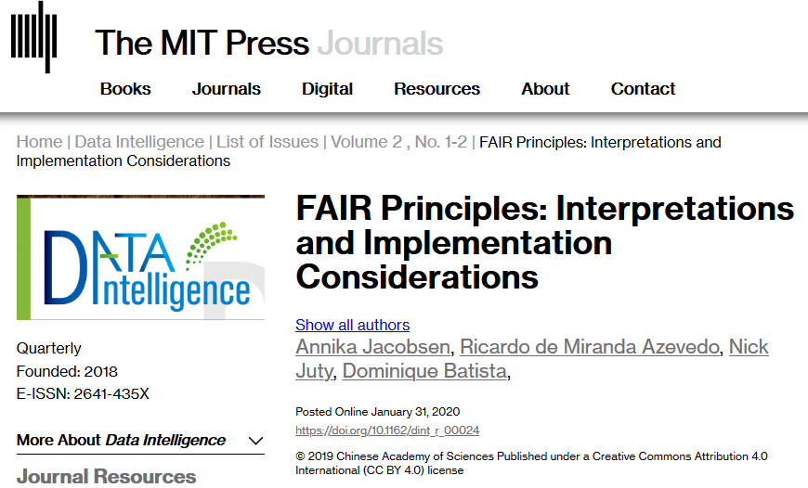
Testing insights |Feedback
Comments on indicators
General issues
Specific issues
Information needs
Need for better explanation of terms, in particular ones that are vague or subjective, e.g. ‘sufficient’
Need for better definition of terms used in FAIR principles, e.g. knowledge representation, FAIR-compliant vocabularies – to take into account https://doi.org/10.1162/dint_r_00024
Need for information on best practices that may be applied to increase FAIRness, e.g. identification, protocols, licences
These issues to be addressed in the Guidelines, using suggestions and examples provide by testers

Slide 27

Scoring mechanism

Slide 28
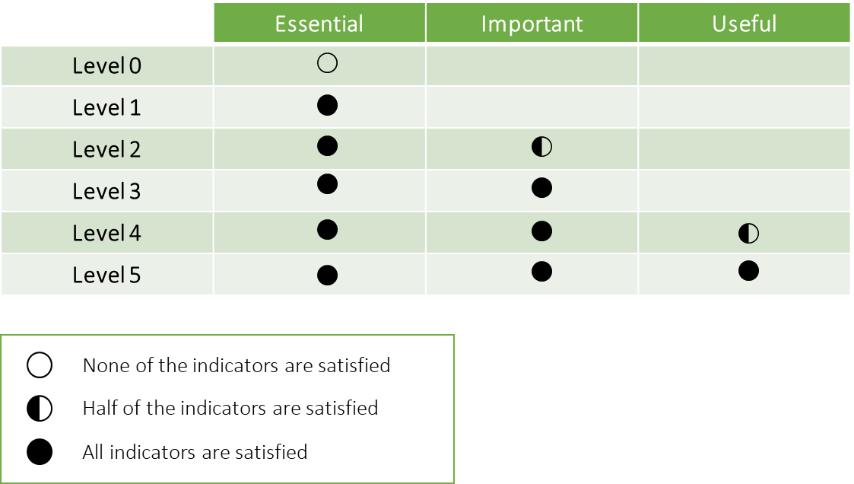

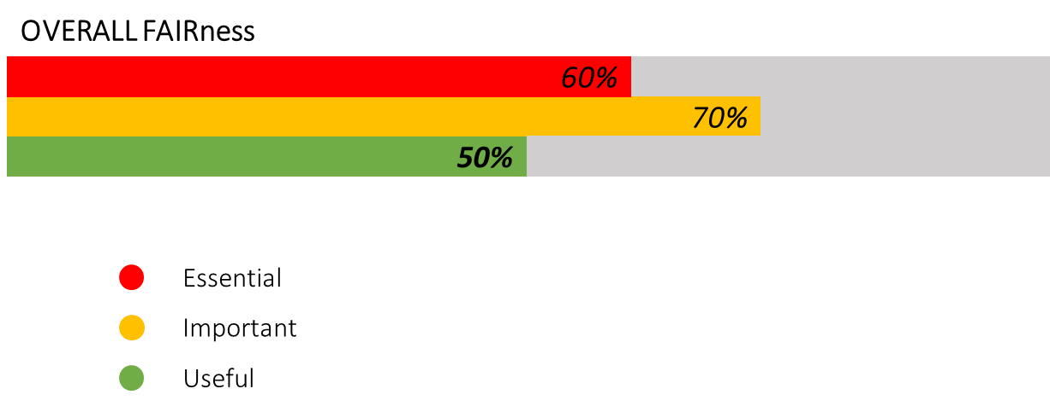
Scoring mechanisms | Overview
5-level scale per indicator
1
2
3
4
5
Five levels of compliance
Per indicator – aggregated per FAIR area
Non applicable or consideration/implementation as options
Useful for giving credit for evolution and helping people to improve
1
2
3
4
5
1
2
3
4
5
FAIRNESS per area
Measurement based on priorities
Per indicator – aggregated per FAIR area
Score determined based on the compliance to priorities
Provides a ‘measure of FAIRness’
Overall FAIRNESS
Measurement based on priorities
Per indicator – overall score
Aggregated score
Provides a quick view of how priorities are met -- but does not give detailed view

Slide 29
Actions items & next steps

Slide 30
Continuity
2020
January | February | March | April | May | June
Testing phase
FAIR data maturity model maintenance (Guidelines, checklist & indicators)
RDA recommendation
End of RDA WG
Workshop
Deliverable

Slide 31
Guidelines | first draft
GUIDELINES | INTRODUCTION | Introduction Objectives Use of the document
 | FRAMEWORK | Indicators Maturity levels Prioritization Indicators description
 | IMPLEMENTATION | How to evaluate

Slide 32




Guidelines | further development
Working Group to share remarks and suggestions about the guidelines
Testing phase will bring out comments and suggestions for change and for additional guidance
Stable version of the guidelines to be published for the next RDA plenary
https://docs.google.com/document/d/1pDGGL3-BbBJu18KlfZUI3AizKLHXGXdIi_mPtpEWmeg/

Slide 33
Action item and next steps
Working Group members are invited to:
Share feedback, comments & suggestions – on the Guidelines
Discuss proposals for changes in priorities on GitHub (issues will be created)
Contribute to GitHub discussion on scoring
We’re also looking for volunteers for further testing; please contact us!
WORKSHOP #8
15th RDA PLENARY IN MELBOURNE
19 March 2020
11.30 – 13h00 (GTM+11) | Breakout 4

Slide 34
Resources
RDA FAIR data maturity model WG
https://www.rd-alliance.org/groups/fair-data-maturity-model-wg
RDA FAIR data maturity model WG – Case Statement
https://www.rd-alliance.org/group/fair-data-maturity-model-wg/case-statement/fair-data-maturity-model-wg-case-statement
RDA FAIR data maturity model WG – GitHub
https://github.com/RDA-FAIR/FAIR-data-maturity-model-WG
RDA FAIR data maturity model WG – Collaborative document
https://docs.google.com/spreadsheets/d/1gvMfbw46oV1idztsr586aG6-teSn2cPWe_RJZG0U4Hg/edit#gid=0
RDA FAIR data maturity model WG – Indicators prioritisation
https://docs.google.com/spreadsheets/d/1mkjElFrTBPBH0QViODexNur0xNGhJqau0zkL4w8RRAw/edit
RDA FAIR data maturity model WG – Indicators prioritisation survey results
https://drive.google.com/open?id=11hyAYCKz_NVoOb9-vlPqjN9LCarOFmc3
RDA FAIR data maturity model WG – Guidelines
https://docs.google.com/document/d/1pDGGL3-BbBJu18KlfZUI3AizKLHXGXdIi_mPtpEWmeg/
RDA FAIR data maturity model WG – Mailing list
fair_maturity@rda-groups.org

Slide 35
Thank you!

