Slide 1
FAIR digital objects in a FAIR Ecosystem –
Certification and Assessment
Mustapha Mokrane, Data Archiving and Networked Services (DANS)
27 February 2020
RDA Germany Conference 2020, Potsdam
@FAIRsFAIR_EU
Notes:
Another “thing” you can do to enhance the FAIR data culture is to improve the capacity for repositories for certification and FAIR. A repository typically offers services that improve the capacity for both certification and FAIR. In these 15 minutes I have with you, I would like to share with you four emerging practical recommendations on repositories and on how they might be adpoted in an approach to the uptake of FAIR data practices. Most important however, is your valuable contribution to help shape these for piloting in years two and three of the project.

Slide 2
How much do you know about the FAIR principles?
Haven’t heard of it
Heard of it, but don’t know much about it
Know the principles, but not in great detail
I know everything about FAIR – Champion ☺

Slide 3

FAIR-y-tale?
“Research data will not become nor stay FAIR by magic. We need skilled people, transparent processes, interoperable technologies and collaboration to build, operate and maintain research data infrastructures.”
Mari Kleemola, Finnish Social Science Data Archive and CoreTrustSeal Board Secretary
https://tietoarkistoblogi.blogspot.com/2018/11/being-trustworthy-and-fair.html
Icon by Freepik from flaticon.com
Notes:
I would like to start with this quote “…” So really, FAIR data won’t happen by magic.
I like the quote in particular, because it sets the context of my presentation here about the role of trustworthy data repositories, as data repositories contain both people, they implement processess and technologies to enable a FAIR ecosystem.

Slide 4
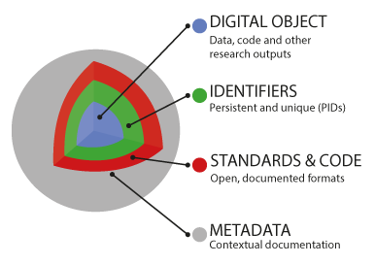
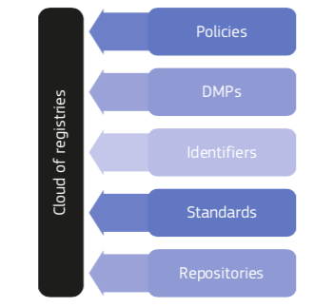
FAIR digital object / FAIR ecosystem
A model for FAIR Digital Objects
The components of a FAIR Ecosystem
Turning FAIR data into reality, Final report and Action Plan from the European Commission Expert Group on FAIR Data
Notes:
This ecosystem is on hand about the FAIR data objects themselves. You see a model for such a FAIR Digital Object on the left hand side. On the other hand, this ecosystem is about more than only the FAIR data objects themselves. I have highlighted the component of repositories here because I think they are of vital importance.

Slide 5
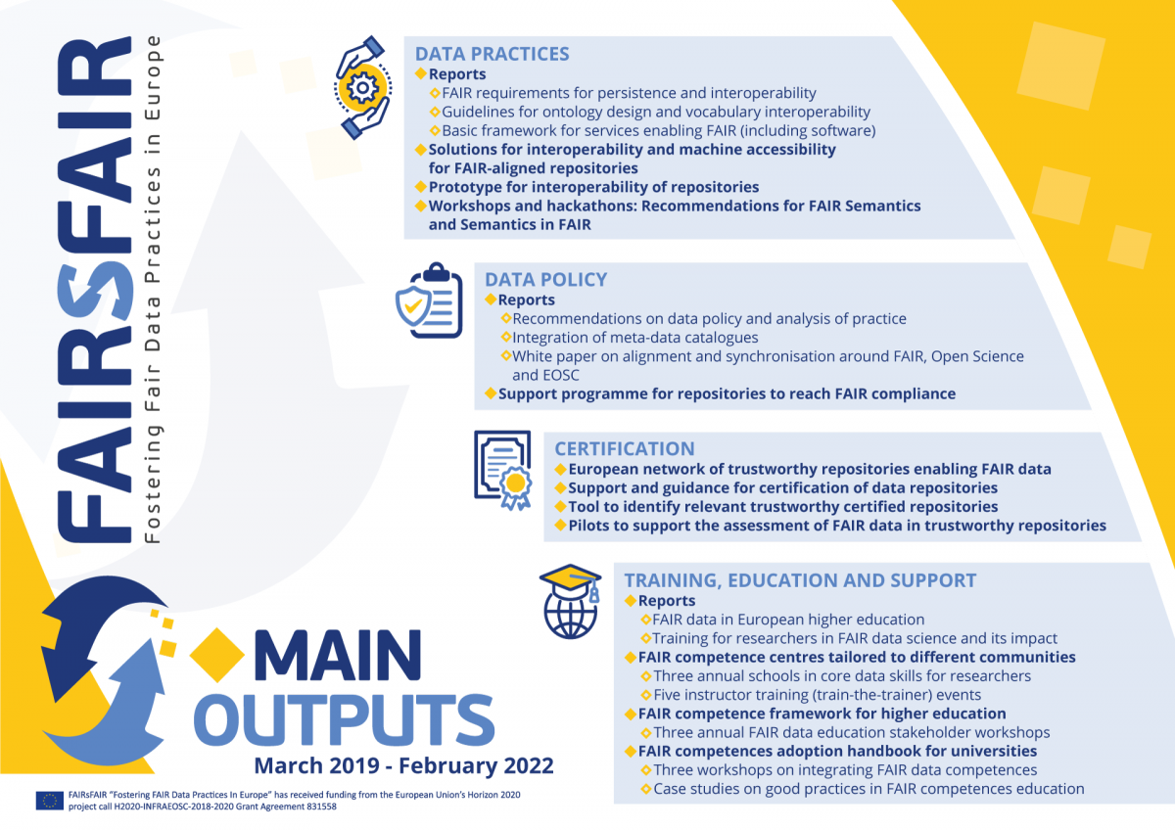
FAIRsFAIR - Fostering FAIR Data Practices in Europe
Aims to supply practical solutions for the use of the FAIR data principles throughout the research data life cycle.
Budget: €10 million
Start date : 1st March 2019
Duration: 36 months
22 partners from 8 member states
Project coordinator :
DANS-KNAW
https://www.fairsfair.eu
Notes:
European Commission’s call INFRAEOSC-05-c (in support of the European Open Science Cloud (EOSC) Governance)
Develop solutions to foster FAIR data culture and the applications of FAIR principes in research data life cycle.
Coordinator: Data Archiving and Networked Services (DANS) is the Netherlands institute for permanent access to digital research resources.
FAIR principles – focus and process (technologies procedures, expertise, people)

Slide 6
Trustworthy repositories enabling FAIR data
Evaluation and certification of repositories
FAIR-elaboration of repository certification requirements
Repository certification and FAIR data complementarity
Measuring the FAIRness of data
Evaluation and certification of FAIR digital objects
Notes:
These practical recommendations are centered around the following three topics.

Slide 7
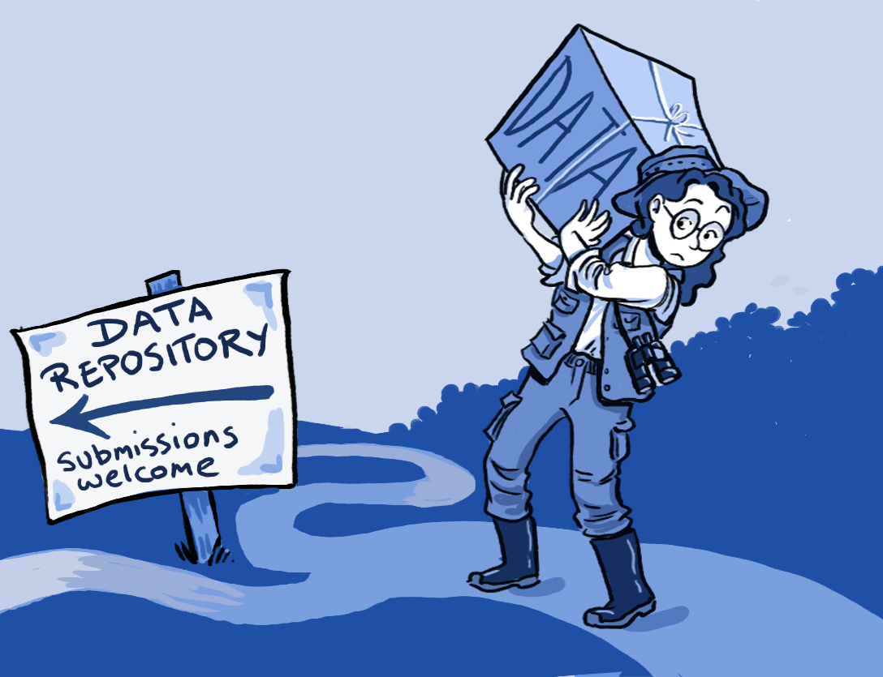
Deposit in a (certified) trustworthy repository
Practices enable FAIR Principles for digital objects
Provides services that ensure FAIRness of your dataset.
Performs long-term stewardship and curation so data remains FAIR over time
Assessed against guidelines to evaluate their trustworthiness
A few certification frameworks exist to assess the quality of a repository: CoreTrustSeal is in common use
Illustration: Ainsley Seago CC BY
See also “Top 10 FAIR Data & Software Things”. Zenodo. http://doi.org/10.5281/zenodo.3409968
See also Mokrane & Recker, 2019. CoreTrustSeal-certified repositories. Enabling FAIR data. https://ipres2019.org/static/pdf/iPres2019_paper_74.pdf
Notes:
Makes life easier for researchers: it can take the burden of individual reserachers in making data FAIR. Much of the work in making and keeping data FAIR is handled by repository services
CoreTrustSeal seeks to offer all basic TDR requirements
CoreTrustSeal offers entry-level repository certification in terms of efforts/resources
→ in line with Turning FAIR into Reality “certification level sought by a given repository should be appropriate and achievable”
Both FAIR and CoreTrustSeal are a result of research data community effort

Slide 8
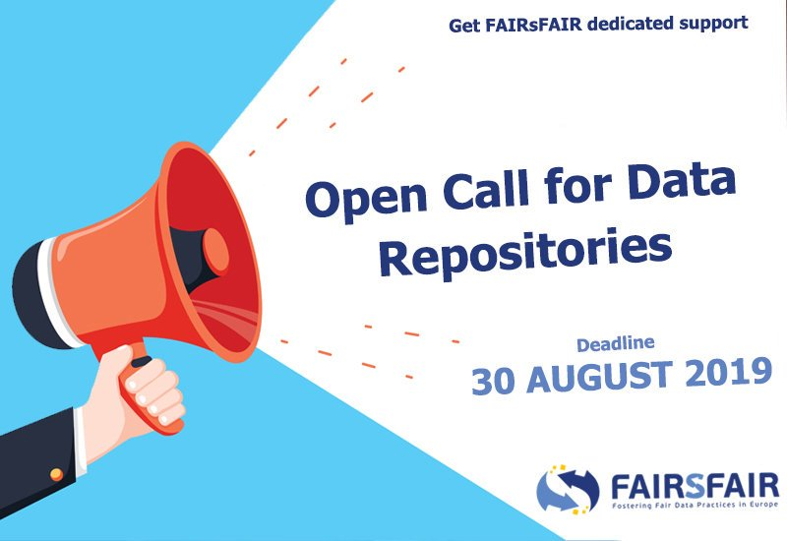

FAIRsFAIR and assessment of FAIR-enabling repositories
Support the FAIR alignment of certification schemes for data repositories, building on existing frameworks such as CoreTrustSeal
Call for repositories involvement – in depth FAIR-aligned certification support - to expand the European network of trustworthy repositories enabling FAIR data
Provide an improved registry for finding and selecting relevant trustworthy repositories

Slide 9
Trustworthy repositories enabling FAIR data
Evaluation and certification of repositories [FAIRsFAIR]
FAIR-elaboration of repository certification requirements
Repository certification and FAIR data complementarity [FAIRsFAIR]
Measuring the FAIRness of data
Evaluation and certification of FAIR digital objects [FAIRsFAIR]

Slide 10
Contribute to the FAIR-elaboration of CoreTrustSeal
by sharing experiences and knowledge of the FAIR Principles as they relate to repositories enabling FAIRness
Mapping of international data repository standards (e.g. CoreTrustSeal) and FAIR
Overlap between FAIR data properties and implications for CoreTrustSeal
Which repository requirements best suppport the enabling of FAIR data?

Slide 11
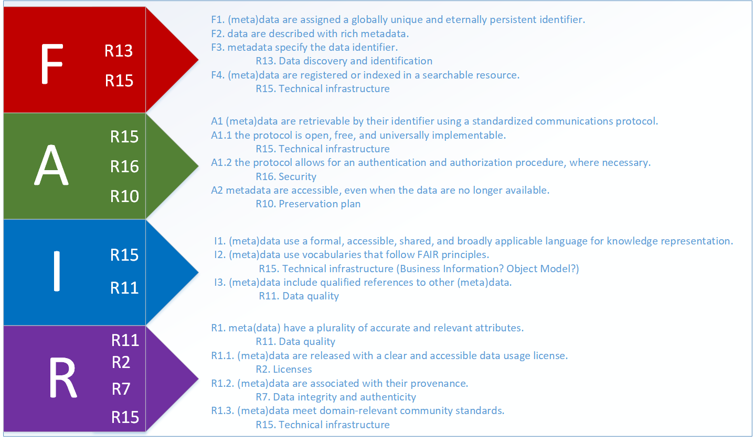
CoreTrustSeal-FAIR mapping
Notes:
This alignment can be illustrated by mapping the FAIR Principles to the CoreTrustSeal requirements as you can see on this table.
This work will be published and will be used as a foundation to facilitate building and assessing the FAIR data ecosystem.

Slide 12
FAIR to CoreTrustSeal
Accessible
  A1 (meta)data are retrievable by their identifier using a standardized communications protocol.
    R15. Technical infrastructure
  A1.1 the protocol is open, free, and universally implementable.
    R15. Technical infrastructure
  A1.2 the protocol allows for an authentication and authorization procedure, where necessary.
    R16. Security
  A2 metadata are accessible, even when the data are no longer available.
    R10. Preservation plan

Slide 13
How do repository requirements enable FAIR data?
e.g.
  R1. Mission/Scope
    Trustworthy Digital Repository Mission Enables FAIR
  R3. Continuity of access
    Organisational Continuity reduces Risk to FAIR Data
  10. Preservation plan
    Preservation ensures FAIR over time

Slide 14
Trustworthy repositories enabling FAIR data
Evaluation and certification of repositories [FAIRsFAIR]
FAIR-elaboration of repository certification requirements
Repository certification and FAIR data complementarity [FAIRsFAIR]
Measuring the FAIRness of data
Evaluation and certification of FAIR digital objects [FAIRsFAIR]

Slide 15




Measuring the FAIRness of data
F. A. I. R. are not new to repositories
FAIR implementation for digital objects not fully defined
How can you tell how FAIR is your research data?
Outcomes & scores: pass/fail vs benchmark/progress (maturity)
FAIR data assessment must include context and infrastructure

Slide 16
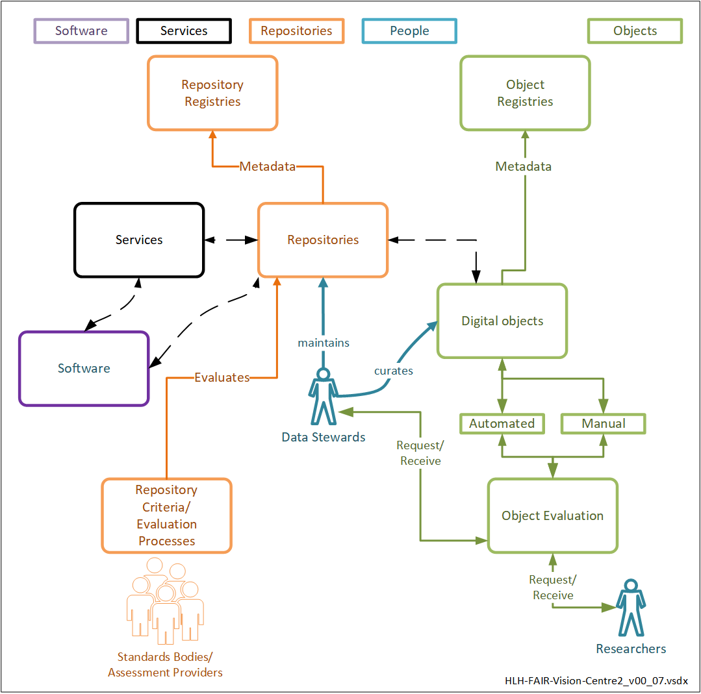
Wider context
FAIR Ecosystem Components: Vision
http://doi.org/10.5281/zenodo.3565428

Slide 17
From Principles to Practice
FAIR principles are not strict measures, but rather ‘fundamental concepts’ which should be further developed and implemented.
Be inclusive – disciplinary practices are heterogeneous (& valid).
Who – Identify and keep the stakeholders in the loop!
When – Integrate FAIR assessment as part of research data lifecycle
FAIR assessment mechanisms
  Manual assessment (e.g., through data authors and stewards) provides insightful analysis, but is not practically feasible.
  Automated assessment saves costs, but at present not all components of the research data ecosystem are machine-friendly.
Technical, non-technical (organization, education) solutions enabling FAIR data are important.
FAIR Data vs. Open Data

Slide 18

FAIR data assessment: levels
DATA REPOSITORY
F4. (meta)data are registered or indexed in a searchable resource
TECHNOLOGIES
PROCEDURES
EXPERTISE
PEOPLE
(META)DATA
F1. (meta)data are assigned a globally unique and persistent identifier
F2. data are described with rich metadata
F3. metadata clearly and explicitly include the identifier of the data it describes
Notes:
A practical example that the context should be considered, I have included this picture.
An assessment of data FAIRness cannot be done only at the level of the metadata/data.
Some FAIR Principles cannot actually be assessed without looking at the data repository level.
For Findability Principles for e.g. Principle F4. Compliance with this Principle cannot be assessed at the metadata or data level.
And even for F1, F2 and F3, ensuring and maintaining compliance will depend on Technologies, Procedures, Expertise, People at the Data Repository level

Slide 19
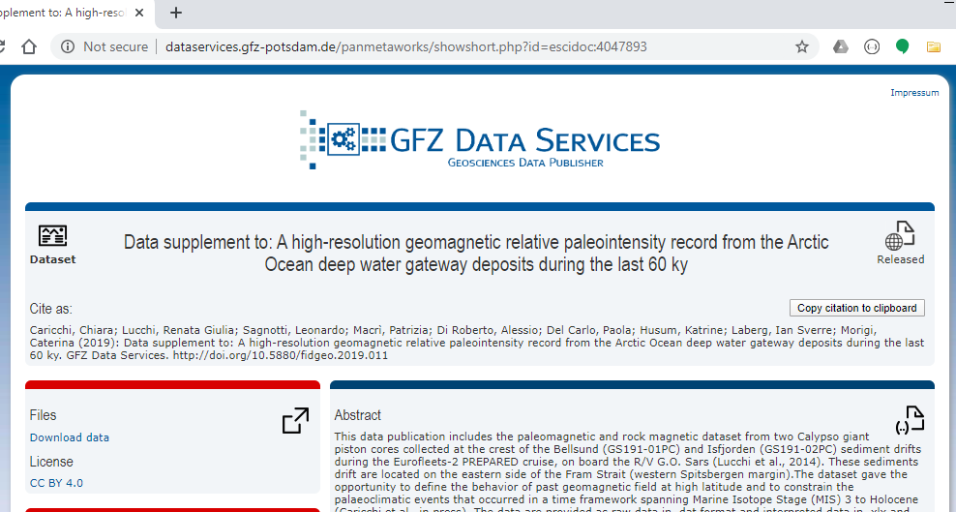

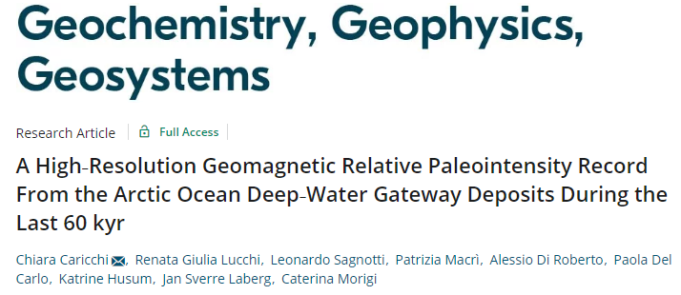
Example (F1 Principle)
(Meta)data are assigned a globally unique and eternally persistent identifier.
http://doi.org/10.5880/fidgeo.2019.011
Resolver Service
Cite
http://dataservices.gfz-potsdam.de/panmetaworks/showshort.php?id=escidoc:4047893

Slide 20
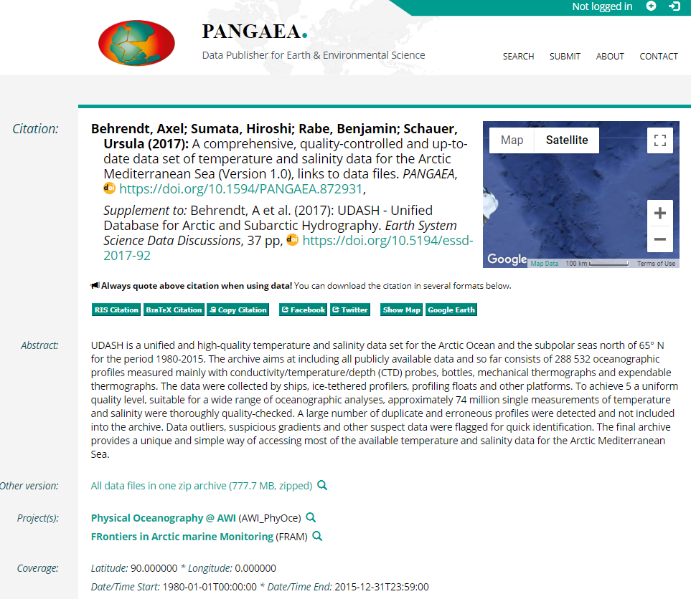
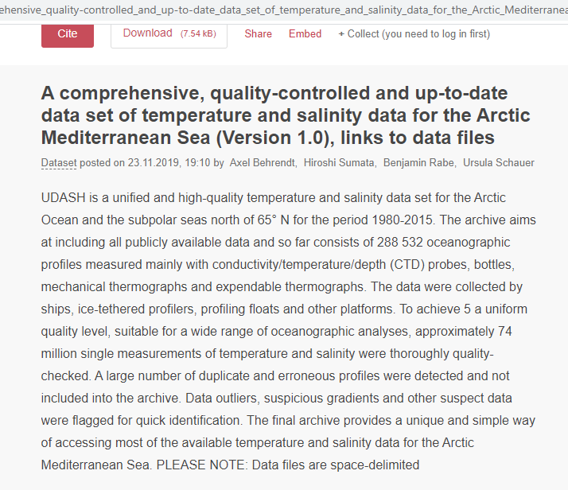
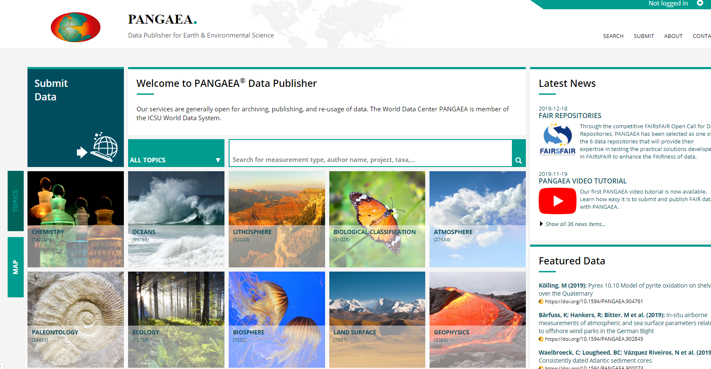

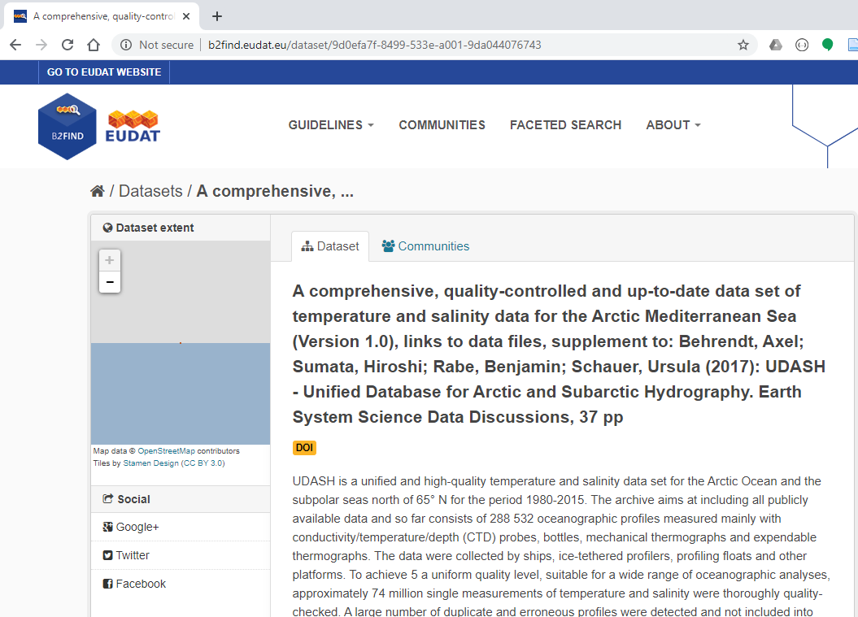
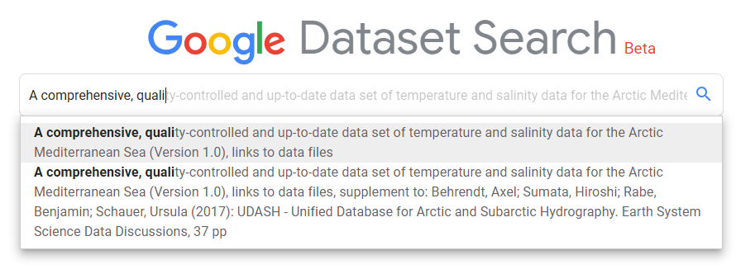
Example (F4 Principle)
(Meta)data are registered or indexed in a searchable resource.
(A Trustworthy Repository for Earth and Environmental Science Data)
A dataset published via PANGAEA

Slide 21

Tools to help assess the FAIRness of data
The RDA FAIR Data Maturity Model WG provides a nice overview of FAIR assessment tools (10+)
  - develops a set of core assessment criteria
  - no definition on how to evaluate the core criteria
FAIR assessment tools:
  - serve a variety of motivations, scenarios and approaches - serve various stages of the research data life cylce
  - serve different stakeholders
Notes:
Overview of FAIR assessment tools: https://docs.google.com/spreadsheets/d/14ojMSXVOITg3RoJn-PuDaPj8zuIGQz2Li-kl97HOBH4/edit#gid=0

Slide 22
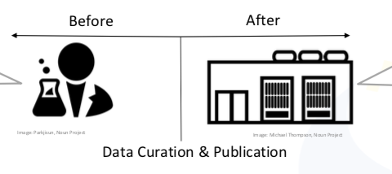
FAIRsFAIR approach to assessment of data FAIRness
Pilots to help support the assessment of FAIR data in trustworthy repositories
Use-case based approach:
  manual self-assessment – researchers – prior to deposit
  automatic assessment – data repository – published data sets

Slide 23
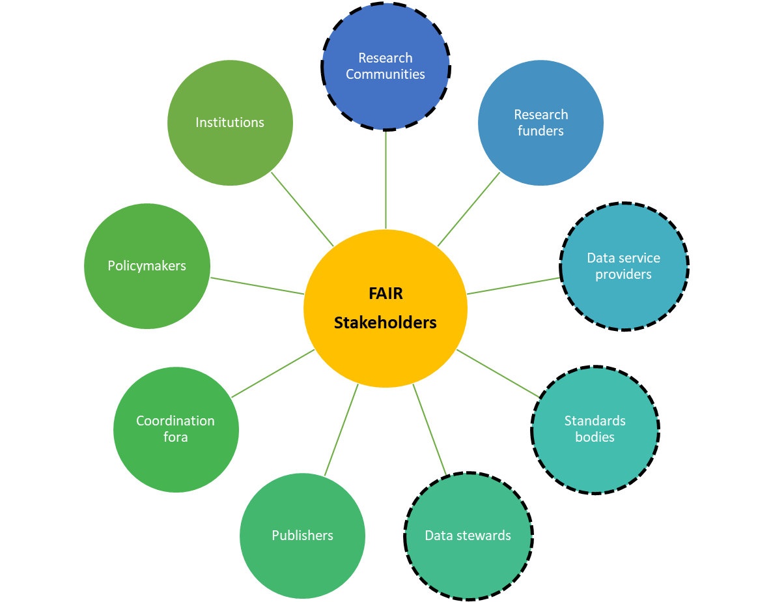
Task 4.5 (FAIR Assessment of Data Objects)
Identify use cases (& stakeholders involved)
Develop requirements (including metrics) to assess the FAIRness of a data object in the context of the selected use cases.
Implement a toolset that enables the stakeholders to evaluate the FAIRness of their data objects.
FAIR stakeholders; figure is derived from 8.3 Stakeholder Groups Assigned Actions (European Commission Expert Group on FAIR Data, 2018). Dotted lines represent the stakeholders of the FAIRsFAIR Task 4.5 use cases.

Slide 24


Use Cases and Stakeholders
Pilot testing will cover 3 additional repositories, e.g., repositories selected through the FAIRsFAIR Open Calls
 | Use Case 1 | Use Case 2
Evaluator | Researchers | Trustworthy Data Repositories
Description | Researchers self-assess their data objects manually to check certain aspects of objects FAIRness before depositing the objects in a repository. | A trustworthy data repository automatically assess its published datasets for their level of FAIRness.
Repository-of-interest | DANS EASY | PANGAEA
Repository domain(s) | humanities, health sciences, social and behavioural sciences, oral history and spatial sciences. | Earth and environmental sciences
Before
After
Trustworthy Data Repositories
FAIR data assessment of published datasets
Researchers
FAIR awareness and education
Image: Parkjisun, Noun Project
Image: Michael Thompson, Noun Project
Data Publication

Slide 25
FAIRsFAIR Data Assessment Metrics
There are 13 metrics built on existing work.
  RDA FAIR Data Maturity Model
  DANS Fairdat/FAIREnough
  WDS/RDA Assessment of Data Fitness
Iteratively improve and extend the metrics through a number of pilot tests.
FAIR Principles | FAIRsFAIR Metric Identifier and Short Name | FAIRsFAIR Metric and Maturity Levels
F1 | FsF-F1-01D Universally Unique Identifier | Does the data have a universally unique identifier assigned? • Yes • No
F1 | FsF-F1-02D Persistent Identifier | Does the data have a persistent identifier assigned? • Yes • No
F2 | FsF-F2-01M Descriptive Metadata | Are metadata elements to support data citation and discovery provided (e.g., creator, title, data identifier, publisher, title, creator, publication date/year, summary/keywords describing the data)? • Not provided • Partially provided • Completely provided
F3 | FsF-F3-01M Inclusion of data identifier in metadata | Does the metadata include the data identifier? • Yes • No
F4 | FsF-F4-01M Searchable metadata | Is the metadata offered in such a way that it can be harvested? • Metadata is not offered • Metadata is offered through a metadata registry, e.g., general-purpose, domain/discipline specific or institutional registries • Metadata is offered as structured data on the data page for use by a web search engine

Slide 26
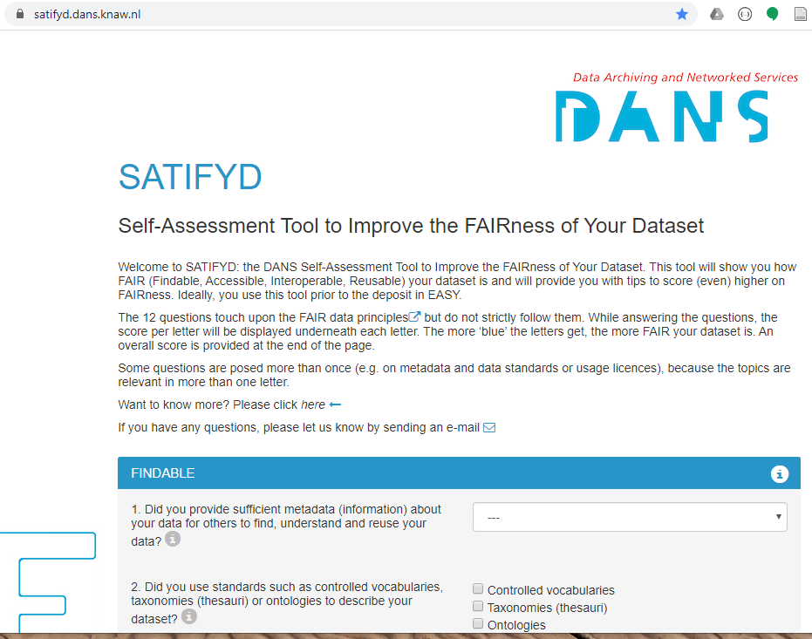
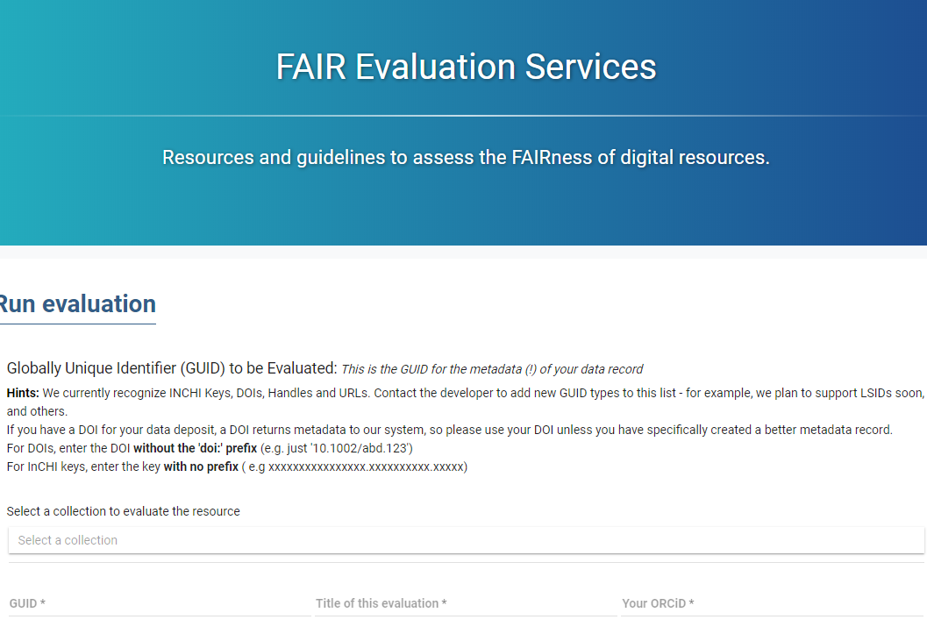

Toolset Implementation
* Wilkinson, Mark D., Michel Dumontier, Susanna-Assunta Sansone, Luiz Olavo Bonino da Silva Santos, Mario Prieto, Dominique Batista, Peter McQuilton, et al. 2019. ‘Evaluating FAIR Maturity through a Scalable, Automated, Community-Governed Framework’. Scientific Data 6 (1): 1–12. https://doi.org/10.1038/s41597-019-0184-5
Use Case 2 (Data Repositories)
Adapt and reuse existing
automated assessment tool*
to evaluate published data objects.
Use Case 1 (Researchers)
prototype available at https://satifyd.dans.knaw.nl/

Slide 27

To remember about measuring FAIR data
Use-case driven approach
Iterative implementation and testing (through pilots)
Adapt and reuse
FAIR for objects is not fully defined
FAIR enabling for repositories evolves in parallel
Other components of the FAIR ecosystem might need evaluation and certification (e.g. services, software)

Slide 28
Conclusions
Feb 2020 - D4.1: Draft recommendations on requirements for FAIR data objects in trustworthy data repositories
https://doi.org/10.5281/zenodo.3678716
Aug 2020 – M4.9 Pilots of FAIR data assessment (DANS EASY, PANGAEA)
Aug 2021 – D4.5 FAIR Assessment of data objects in 5 repositories implemented and tested.
If you would like to participate in pilot testing, please contact adevaraju@marum.de

Slide 29
Thank you for your attention!
Slide acknowledgements:
Ilona von Stein (DANS)
Anusuriya Devaraju (PANGAEA)
Herve L’Hours (UKDA)
www.fairsfair.eu
@FAIRsFAIR_EU

