Slide 1



GO FAIR Initiative
Supporting a community towards convergence
@ RDA DE 2020
February 27, 2020
GO FAIR receives funding from
Silvia Wissel
GO FAIR International Support & Coordination Office Hamburg
s.wissel@zbw.eu

Slide 2
Agenda
  Introduction GO FAIR Initiative and Objectives
  Who is part of GO FAIR
    GFISCO (GO FAIR International Support and Coordination Office)
    Implementation Networks
  Convergence as major topic
  Planned activities and how to get involved

Slide 3
GO FAIR Initiative
Started in 2017 by the Science Ministries of Germany, The Netherlands and France as stepping stone towards the European Open Science Cloud (EOSC)
Open and inclusive environment for anyone committed to defining and creating elements of the Internet of FAIR Data & Services (IFDS)
Bottom up, open to all, cross border, cross discipline
Goal: Broad acceptance and application of FAIR principles

Slide 4
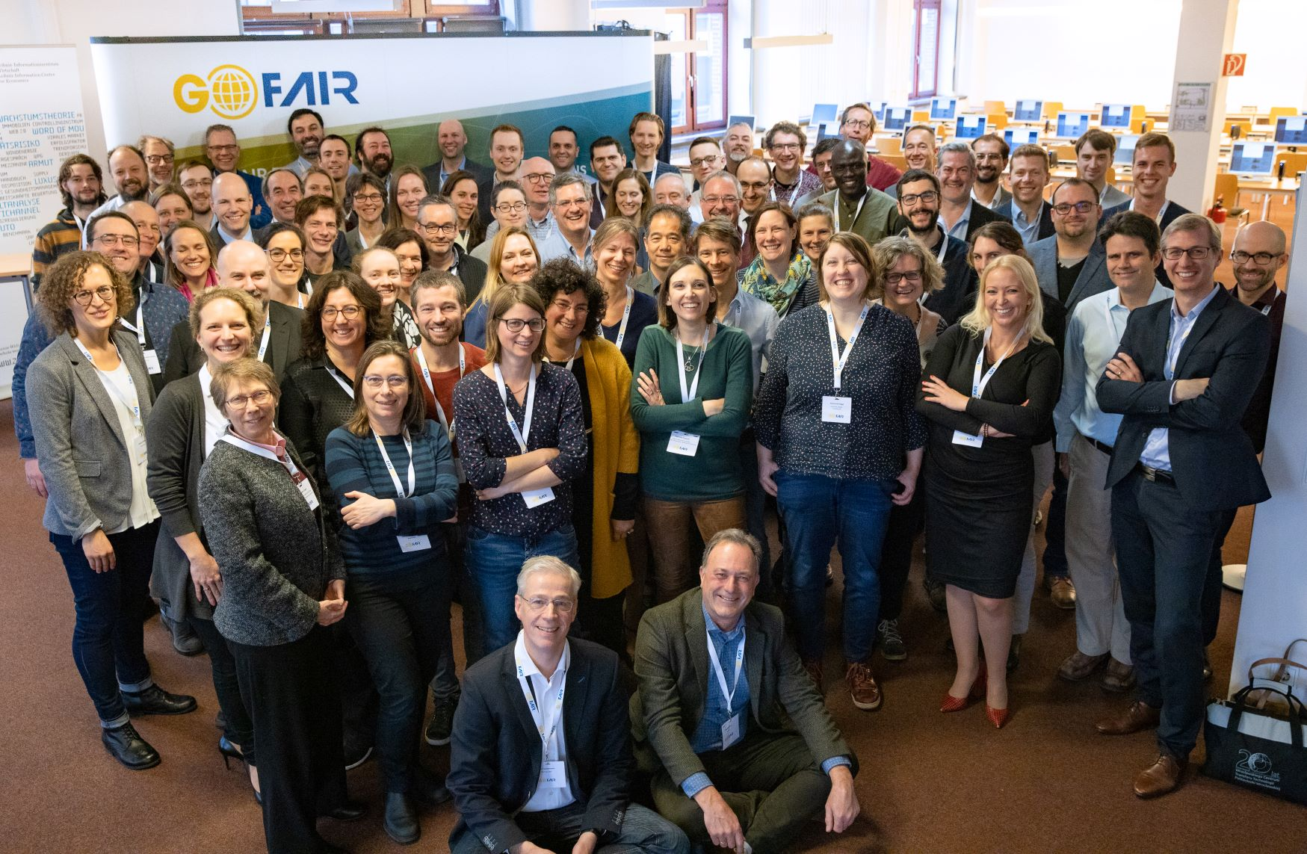
Who is “GO FAIR”?
GO FAIR Annual Meeting, January 24 2020, Hamburg

Slide 5
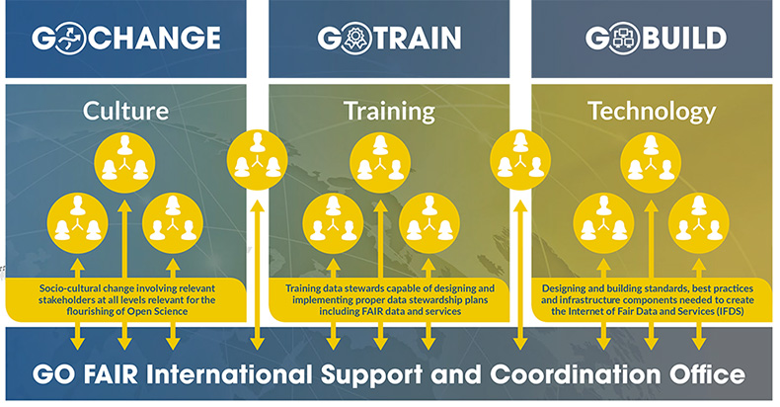
Who is “GO FAIR”?
Initiative for people, organisations or projects, committing to the FAIR-Principles with specific implementation plans
Members are organised in Implementation Networks across three pillars:
„GO CHANGE“, GO TRAIN“ und „GO BUILD“
Implementation Networks are open
Added value for Implementation Networks:
  Exchange, Synergies, Compatibility
  Avoid reinventing the wheel
  Support from the GO FAIR-Office

Slide 6
GO FAIR International Support and Coordination Office
Serving as a hub → broadening network and coordination across
  Implementation Networks
  Other relevant networks/projects
Assistance with the formulation of manifestos, priorities, roadmaps
Organisation of workshops and meetings for knowledge exchange and knowledge transfer with some travel budget support
Identify and ensure synergies between Implementation Networks
Promote IN outcomes and best practices to increase visibility
Communications and collaboration support, i.e. mailing lists, newsletter, teleconferencing account

Slide 7
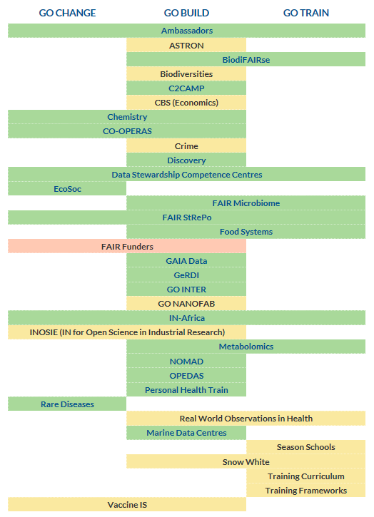

IMPLEMENTATION NETWORKS
21 active Implementation Networks
Members of the GO FAIR Initiative
Consortia of individuals, institutions, or projects with a common implementation goal towards FAIR
Implementation Networks reuse, adjust or - in some cases – create entirely new tools, schemas, resources, workflows
Link to Manifesto
Data Stewardship Competence Centres IN, some planned tasks:
Co-develop and share awareness building methods and good practices in FAIR research data stewardship.
Share and where needed participate in the development of e-learning tools, courses and curricula for professional data stewards.
Share and co-develop approved incentives for research data stewardship.
Kick-off Meeting German National Chapter on April 2 @ University of Erfurt (contact: Monika Linne)

Slide 8
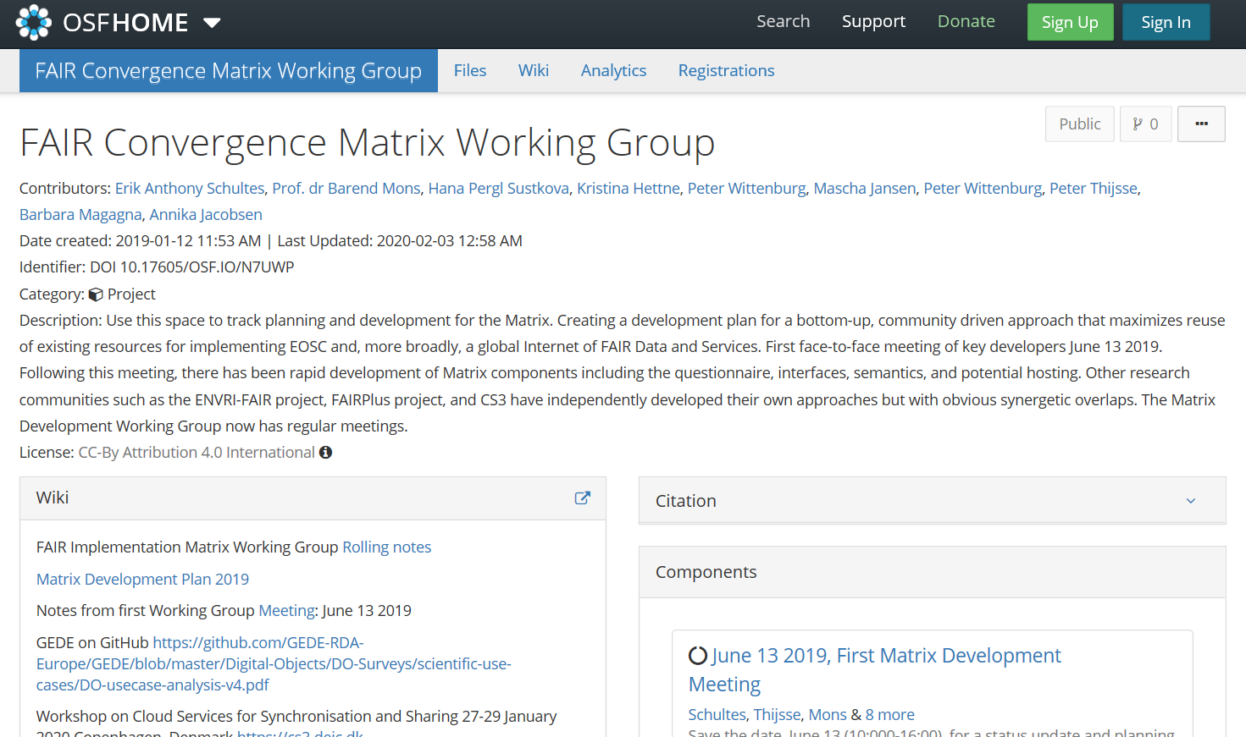
Topic 2020: FAIR Convergence
Convergence is when a critical mass of stakeholders voluntarily choose for the same or compatible standards and technologies.
Convergence is a bottom-up process involving complex decisions among multiple stakeholders.
This makes convergence difficult to steer or even predict.
One process: FAIR CONVERGENCE MATRIX WORKING GROUP
Ref: P. Wittenburg & G. Strawn (2018).Common Patterns in Revolutionary Infrastructures and Data. Available at: https://www.rd-alliance.org/sites/default/files/Common_Patterns_in_Revolutionising_Infrastructures-final.pdf

Slide 9
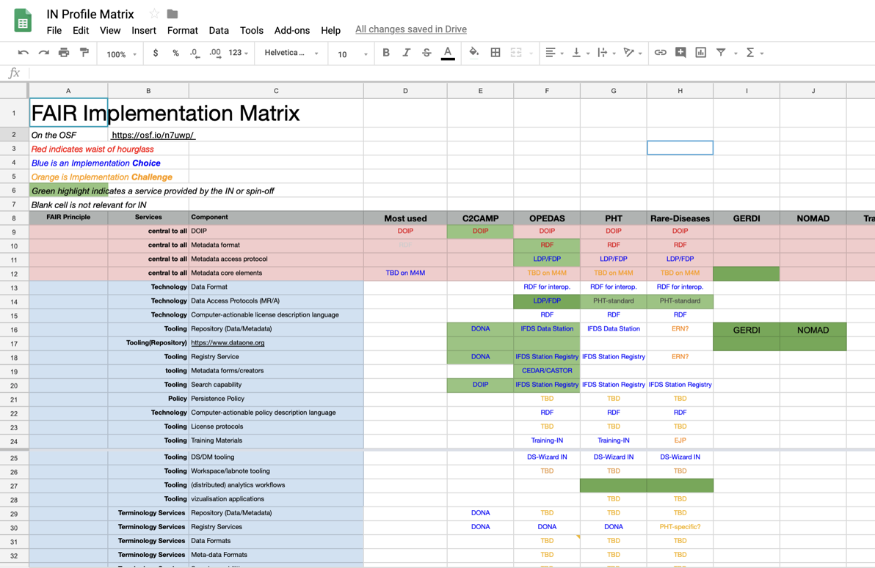
CONVERGENCE MATRIX AND FAIR IMPLEMENTATION PROFILES
Example: Convergence on FAIR Data Trains:
Meeting December 2019
visualizing choices & challenges and the principles that are referred to: F, A, I or R
A choice for one might be a challenge for the other, groups can learn from each other
Contact: Oya Beyan, Personal Health Train Implementation Network

Slide 10
Convergence Topics of Implementation networks
Annual meeting January 2020 breakout sessions of INs:
Distributed learning on federated data
How could the FAIR Digital Object (FDO) help/be used to support the data trains? (PHT IN)
FAIR data objects: The creation of FDO specification for use across all domains. (Chemistry IN), (FAIR Microbiome IN)
Semantic interoperability (GO Inter IN)
Data stewardship competences – terminology, training materials (DSCC IN)
GO Change: Scaling FAIR to industry and global goals (SDGs) (FOOD Systems IN)
Discovery: how to make your data discoverable (Discovery IN)

Slide 11
Planned Events and workshops for 2020
April 2: Kick-off Meeting German Chapter of Data Steward Competence Center IN, Erfurt
Several Convergence workshops (two planned on semantic interoperability – See also poster from Peter Mutschke – GO Inter)
FAIR Convergence Symposium, October 22-23 2020, Paris, France (venue TBC)
How to get involved?
Implementation Networks are open so you can also join
  Go to GO-FAIR.org and read through manifestos, they include contact persons, or sign up as member directly
Sign up to our Mailinglist and follow upcoming events

Slide 12




Thank you!
Contact:
Silvia Wissel| s.wissel@zbw.eu
GO FAIR International Support & Coordination Office
ZBW – Leibniz Information Centre for Economics
www.go-fair.org
@GOFAIRofficial

