Slide 1






FAIR Data Infrastructures for Biomedical Research
Martin Golebiewski
HITS gGmbH
Heidelberg (Germany)
martin.golebiewski@h-its.org

Slide 2




FAIRDOM data management: Share your data FAIR
www.fair-dom.org
Findable
Accessible
Interoperable
Reusable
Data
Operating procedures
Models

Slide 3














FAIRDOM
Pillars and activities
Community Actions
Models
version,
tracking
provenance
parameters
citation
Project Stewardship Services
Data
Workflows
A Central Public Hub for Projects
Samples
metadata
Articles
Presentations
events
Project Specific Installations
Metadata People Processes
Software Platform + Tools

Slide 4


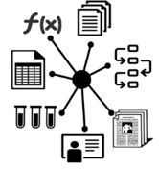









FAIRDOM
FAIRDOM asset management ecosystem of resources
Front end
Projects Hub
Entry Point
Web-based portal
Project spaces
Metadata catalogue
Yellow pages
Results repository
Collaboration
Archives Gateway
Sharing
Organisation
Tracking
Pipelines
LIMS, Instruments
Large data
Samples
Auto-archiving
Back end
Onsite storage & analytics

Slide 5














FAIRDOM
SEEK as a local (project-specific) instance or as FAIRDOMHub in the cloud
Service hosted at HITS
(Institutional Guarantee at least until 2029)
Wolstencroft, Owen, Krebs, Nguyen, Stanford, Golebiewski, et al. (2015): SEEK: a systems biology data and model management platform,
BMC Systems Biology, 9:33 (doi: 10.1186/s12918-015-0174-y)

Slide 6
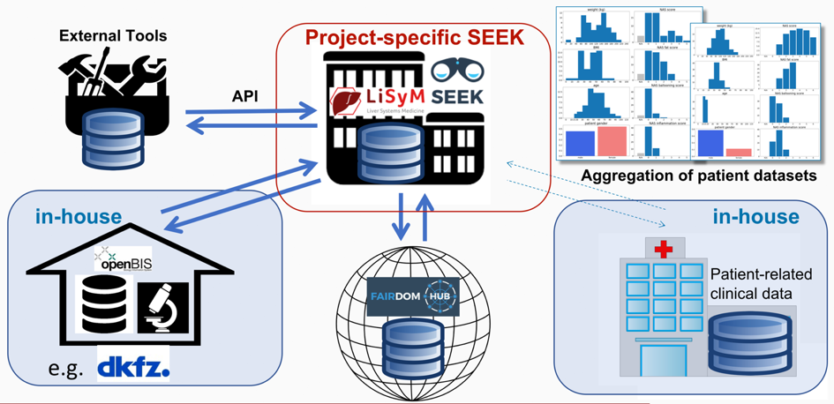
FAIRDOM
Project-specific support for research networks:
e.g. German Liver Systems Medicine Network (LiSyM)

Slide 7
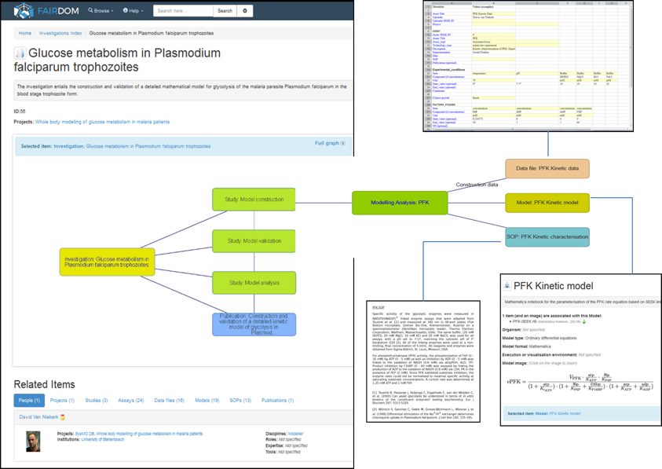
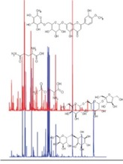


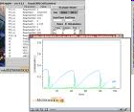
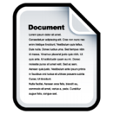
FAIRDOM
Structuring data in SEEK
Data
Study
Analysis
Model
(Assay)
SOP
Investigation
SOP

Slide 8
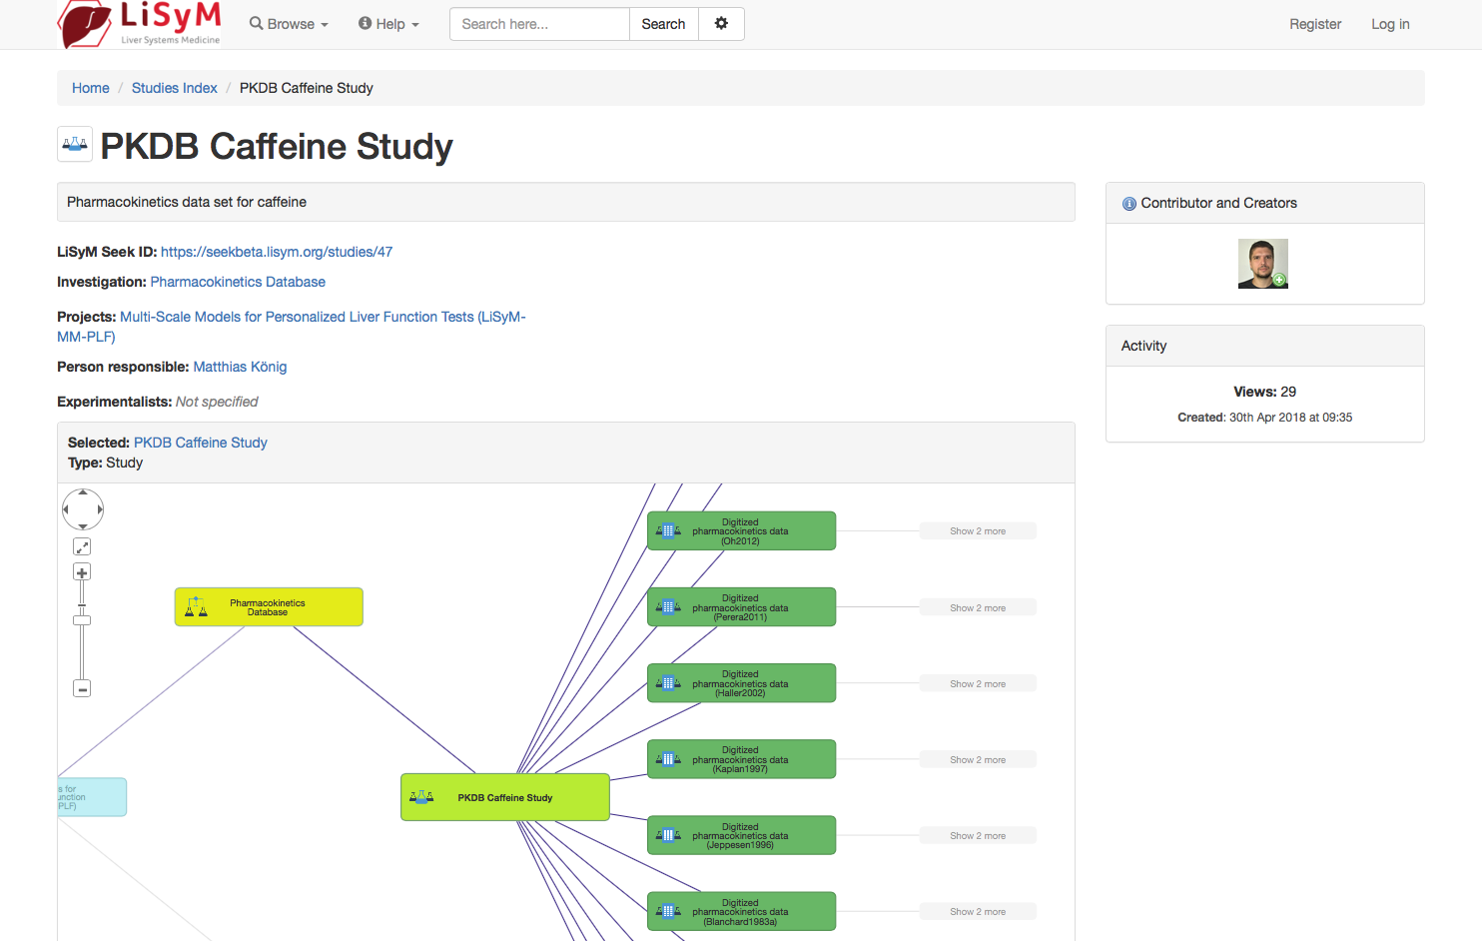
FAIRDOM
Structuring data in SEEK
e.g. structured data transfered to LiSyM SEEK by Matthias König (Charité Berlin) by using the
LiSyM SEEK API

Slide 9
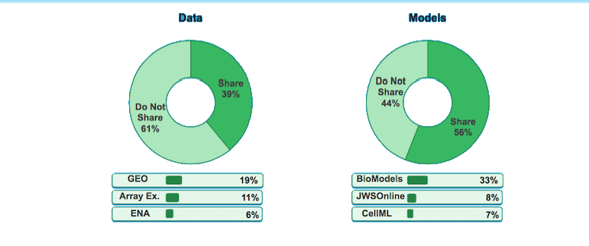
Many researchers do not share their data/models
Data
Models
*top three most popular
The evolution of standards and data management practices in systems biology (2015). Stanford, Wolstencroft, Golebiewski, et al., Molecular Systems Biology, 11(12):851

Slide 10

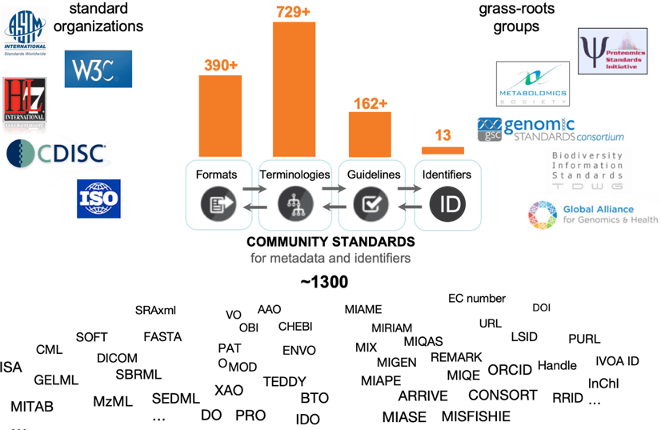
The Forrest of Standards in Life Sciences
Source: Susanna-Assunta Sansone (University of Oxford, UK)

Slide 11
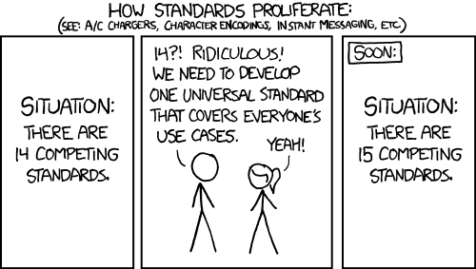
So many standards... How to avoid becoming lost ?
© xkcd
https://xkcd.com/927/
Golebiewski M: Data Formats for Systems Biology and Quantitative Modeling,
In: Ranganathan S., Nakai K., Schönbach C. and Gribskov M. (eds.) Encyclopedia of Bioinformatics and Computational Biology, Volume 2, 2019, Pages 884-893

Slide 12

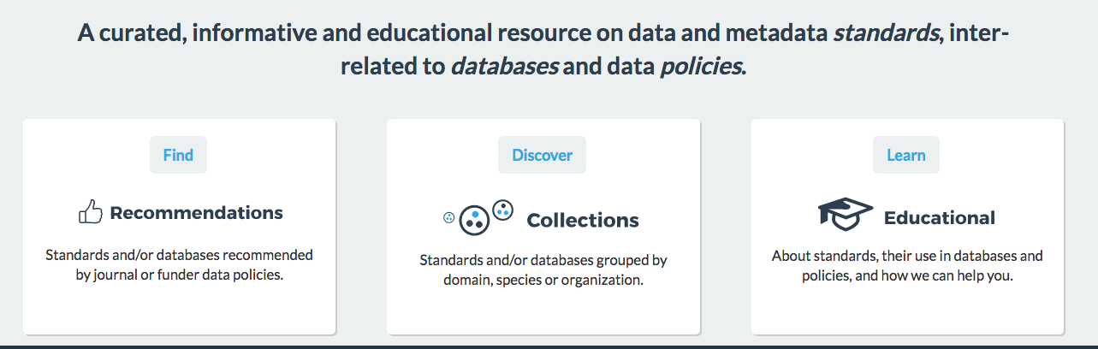
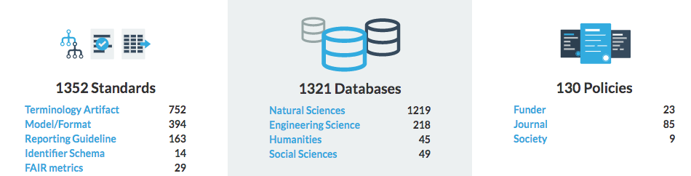

Slide 13

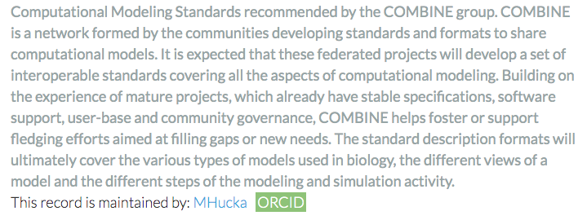


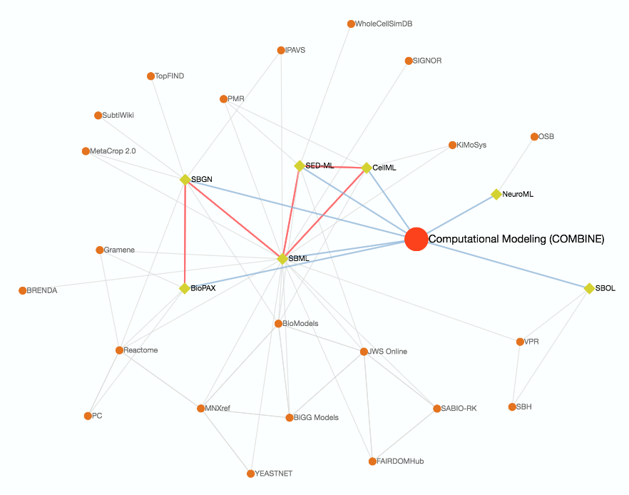
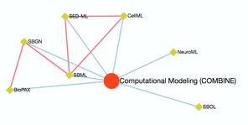
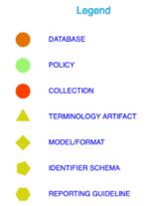
Displaying the repositories that implement the COMBINE standards
https://fairsharing.org/collection/ComputationalModelingCOMBINE

Slide 14
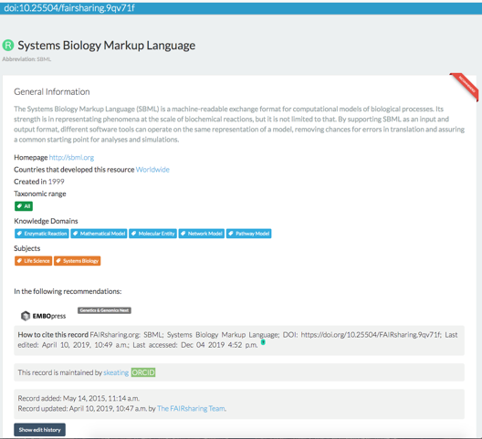
https://doi.org/10.25504/FAIRsharing.9qv71f

Slide 15




















From de facto to de jure Standards: Universe of SDOs

Slide 16

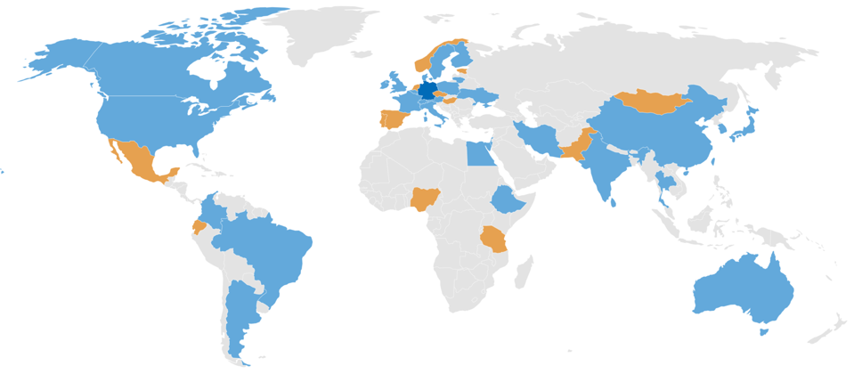
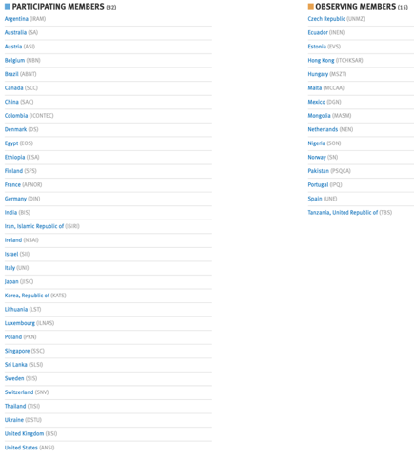
ISO/TC 276 Biotechnology
http://www.iso.org/
Scope:
Standardization in the field of biotechnology processes that includes the following topics:
- Terms and definitions
- Biobanks and bioresources
- Analytical methods
- Bioprocessing
- Data processing, annotation, analysis, validation, comparability and integration

Slide 17


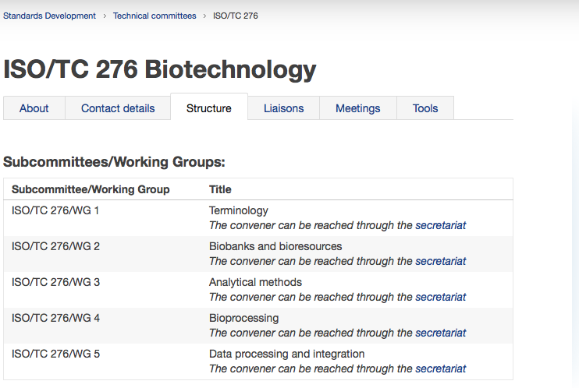

Chair: Ricardo Gent, Deutsche Industrievereinigung Biotechnologie im VCI e.V. (Germany)
Convenor: Michael Kahnert, BIO Deutschland (Germany)
Convenor: Georges Dagher, INSERM (France)
Convenor: Sheng Lin-Gibson, NIST (USA)
Convenor: Tatsuo Heki, FUJIFILM (Japan)
Convenor: Martin Golebiewski, HITS gGmbH (Germany)
Secretariat:

Slide 18
ISO/TC 276/WG5 Data Processing and Integration
Scope:
To develop standards for traceable, searchable, and interoperable data together with integrated data processing for biotechnology/life sciences.
The main foci are:
- Definition of data and model formats and their interfaces
- Definition of metadata and relations of data and models
- Quality management of processed data and models
WG 5 builds on existing community standards and develop standards where required and where gaps are identified.
WG 5 coordinates its work with relevant technical committees and standardization initiatives. This includes coordination with all working groups of ISO/TC 276.

Slide 19
ISO/TC 276/WG5 Data Processing and Integration
Convenor: Martin Golebiewski (Germany) Secretary: Ms. Xinyang Zhang
Co-Convenor: Yong Zhang (China) (China)
111 Committee members + 10 liaison representatives + 12 document monitors
from 21 countries:
Brazil, France, United States, United Kingdom, Germany, Ukraine, Luxembourg, Argentina, Iran, Japan, Korea, Belgium, Australia, China, Canada, Finland, Israel, Sweden, Singapore, Thailand, Italy
Liaisons:
ISO/JTC1/SC29/WG11 Coding of moving pictures and audio (MPEG)
ISO/TC34/SC9 Food Product/Microbiology
ISO/TC34/SC16 Food Product/Horizontal Methods for Molecular Biomarker Analysis
ISO/TC215 Health informatics
BBMRI-ERIC (Biobanking and BioMolecular Resources Research Infrastructure)
EU-STANDS4PM (European standards for in-silico modelling in personalized medicine)
GA4GH (Global Alliance for Genomic Health)

Slide 20
ISO/TC 276/WG5 Data Processing and Integration
 | Project No. | Project title | Project leader | Current stage
1 | ISO/CD 20691 | Biotechnology- Requirements for data formatting and description in the life sciences for downstream data processing and integration workflows | Martin Golebiewski | CD
2 | ISO/DIS 21710 | Biotechnology - Data management and publication in microbial biological resource centers | Juncai Ma (China) | DIS
3 | ISO/AWI TR 3985 | Biotechnology - Data publication –Part1: Consideration and Concepts | James Sluka (USA) | AWI (update 5.11.2019)
4 | ISO/AWI 23494-1 | Biotechnology -Provenance information management –Part1: considerations and concepts | Petr Holub (BBMRI) & Jörg Geiger (Germany) | AWI
5 | ISO/PWI 23494-2 | Biotechnology -Provenance information management –Part2: Common Provenance Model | Petr Holub & Jörg Geiger | PWI submitted to WG5
Current Standardisation Projects:

Slide 21
ISO/TC 276/WG5 Data Processing and Integration
 | Project No. | Project title | Project leader | Current stage
5 | ISO/PWI 22860 | Biotechnology-Biotechnology — Metadata specifications for human cells | Lei Guo (China) | “frozen”
6 | ISO/WD 20397-2: (WG3-led) | Biotechnology – General requirements for massive parallel sequencing – Part 2: Method to evaluate the quality of sequencing data. | Yong Zhang (China) | CD comments collected
7 | PWI 24420 | General requirements for data processing of metagenomics | Ran Wang/Juncai MA | WG5 recomm. NP ballot
7 | Joint project with MPEG | Genomic compression and storage | Marco Mattavelli
8 | ISO/PWI 24480 | Validation of database used for nucleic acid sequence evaluation | Hiroki Nakae | PWI comments collated
Current Standardisation Projects:

Slide 22
ISO/CD 20691: Requirements for data formatting and description in the life sciences for downstream data processing and integration workflows
ISO/TC 276 Biotechnology WG 5 (Data Processing and Integration) works on a draft for a new ISO standard in the life sciences:
Reference framework („hub“) standard for (non-ISO) community standards:
Requirements and rules for the application of community standards for the formatting and documentation of data and computer models in the life sciences
Recommended workflows for the structured processing, storing and integration of data and corresponding computer models
Catalogue of criteria and requirements for life science data formats and model formats as prerequisites for a framework of interoperable standards

Slide 23
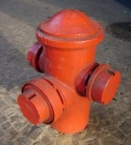
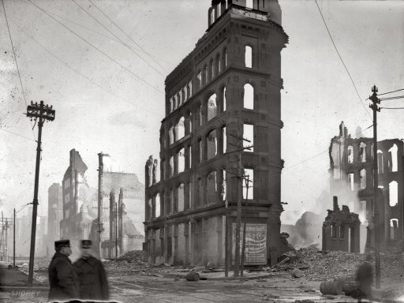

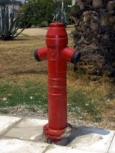
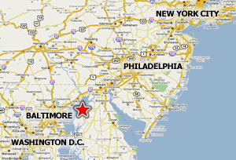
Need for a meta-standard for community standards
Example: Great Baltimore fire of 1904
Individual fire hydrants with 600 different variations of hose couplings
→ Need for interoperability standards

Slide 24
Table of Content for ISO/CD 20691:
Requirements for data formatting and description in the life sciences for downstream data processing and integration workflows
Foreword
Introduction
1 Scope
2 Normative references
3 Terms and definitions
4 Criteria for formats and identifiers
5 Technical criteria and requirements
6 Semantic criteria and requirements
7 Requirements for ontologies suitable for annotation of biological data
8 Requirements for domain specific data standards
9 Requirements for data repositories for biological data
Annex A (informative) Recommended formats for life science data
Annex B (informative) Minimal reporting standards for data, models and metadata

Slide 25
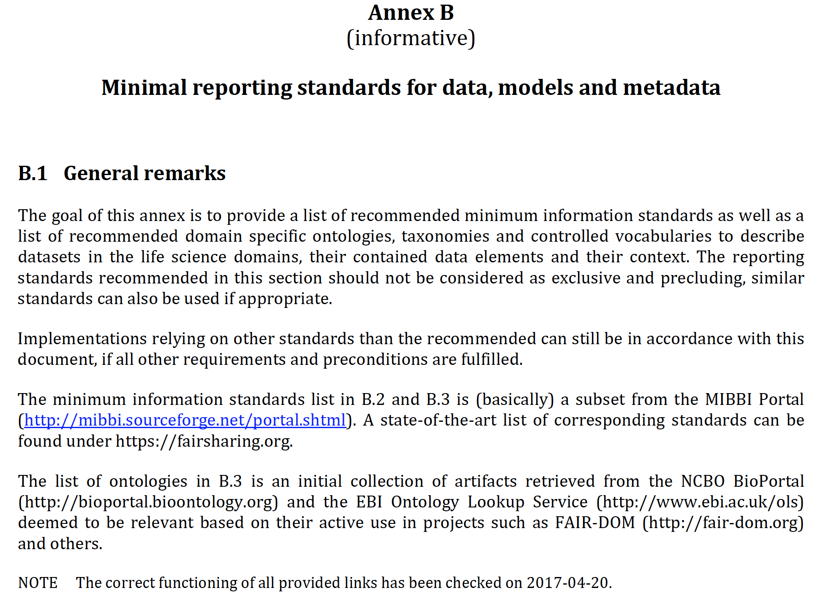
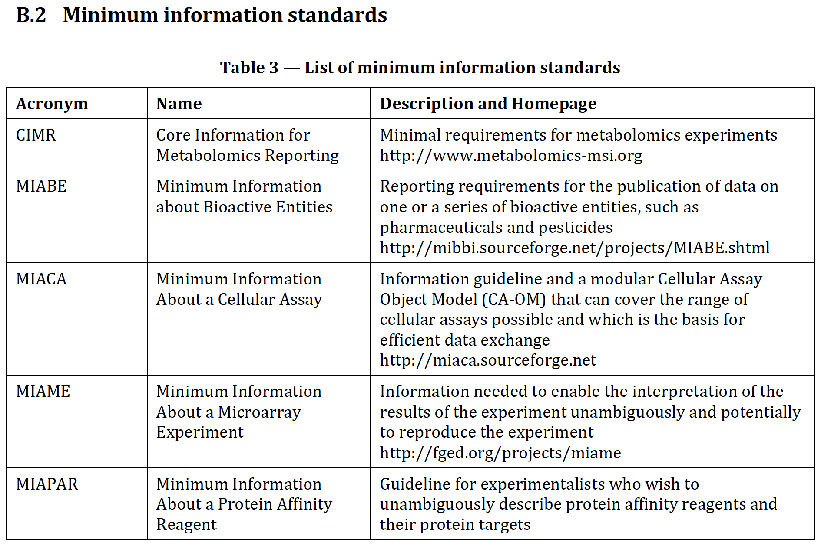
ISO/CD 20691

Slide 26
GMDS Project Group:
FAIR Data Infrastructures for Biomedical Informatics
within the German Association for Medical Informatics, Biometry and Epidemiology - Deutsche Gesellschaft für Medizinische Informatik, Biometrie und Epidemiologie (GMDS)
Aims
Bundle the different FAIR data infrastructure activities in projects and at research sites
Exchange of information and experiences across the biomedical community with the aim of supporting the harmonization of the parallel activities:
- Standardization of data, metadata and data models (including persistent identifiers)
- Consistent semantic description by controlled vocabularies and ontologies
- Transferring FAIR data management experiences across the community and from other research communities
Development of a common understanding of FAIR data, open data and open access, within the specific legal and data security framework in the biomedical field
Collect and analyze requirements for FAIR data infrastructures and their implementation
Extraction and joint development of best practices

Slide 27
GMDS Project Group:
FAIR Data Infrastructures for Biomedical Informatics
Activities:
Online and face-to-face meetings for information exchange and reporting experiences
Building a bridge between domain-specific FAIR data management service providers and (potential) users from the research community
Establishing FAIR Data Guiding Principles in the GMDS community (and beyond)
Workshops: e.g. September 8th, 2020 at GMDS annual conference in Berlin
Cross-linking of data management systems and exisiting/planned projects
Registry for FAIR data repositories in biomedical research (build on FAIRSharing.org)
Joint development of approaches for interoperability of data, metadata and services
Coordination of standardization activities and discussion of data/metadata standards
Development of guidelines for building FAIR data resources for biomedical research
Creation of online tutorials (planned)

Slide 28
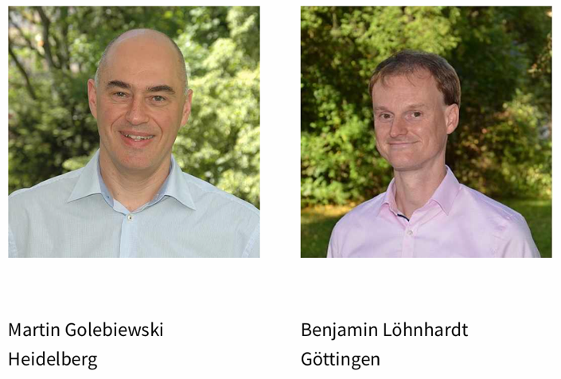
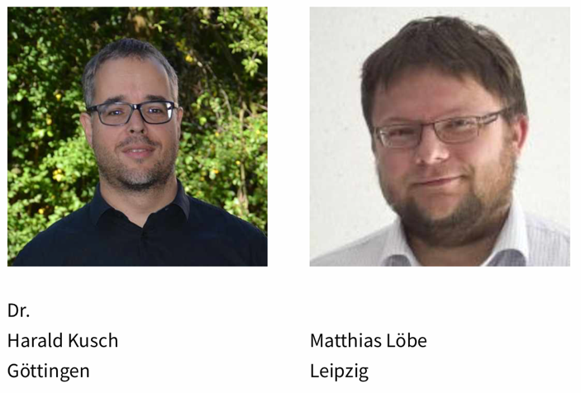
GMDS Project Group:
FAIR Data Infrastructures for Biomedical Informatics
Leadership
Chair
Co-Chair
Co-Chair
Co-Chair

Slide 29
GMDS Project Group:
FAIR Data Infrastructures for Biomedical Informatics
Collaborations:
European FAIR data initiatives: FAIRDOM, GO FAIR, FAIRplus, FAIR4Health, FAIRsFAIR
Research Data Alliance (RDA)
European Open Science Cloud (EOSC)
Collecting domain-specific requirements for a national research data infrastructure in Germany (NFDI) and transferring them to NFDI4Health and GHGA
German Medical Informatics Initiative (MI-I)
German Network for Bioinformatics Infrastructure de.NBI (German ELIXIR node)
EU-STANDS4PM (European project for standardization in personalized medicine)
Standardization committees national (DIN) and international (ISO and CEN/CENELEC), especially ISO/TC 215 „Health Informatics“ and ISO/TC 276/WG5
International community standardization initiatives and organizations: HL7 (Health Level 7), CDISC (Clinical Data Interchange Standards Consortium), COMBINE (Computational Modeling in Biology Network), GA4GH (Global Alliance for Genomics and Health)
GMDS working and project groups

Slide 30

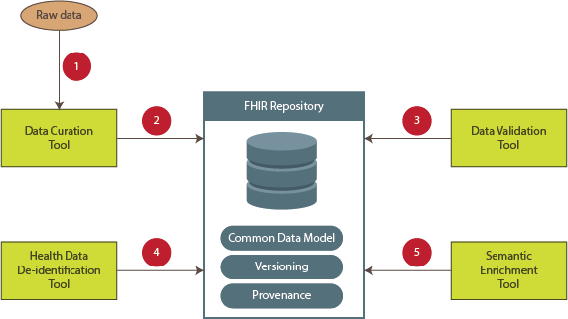
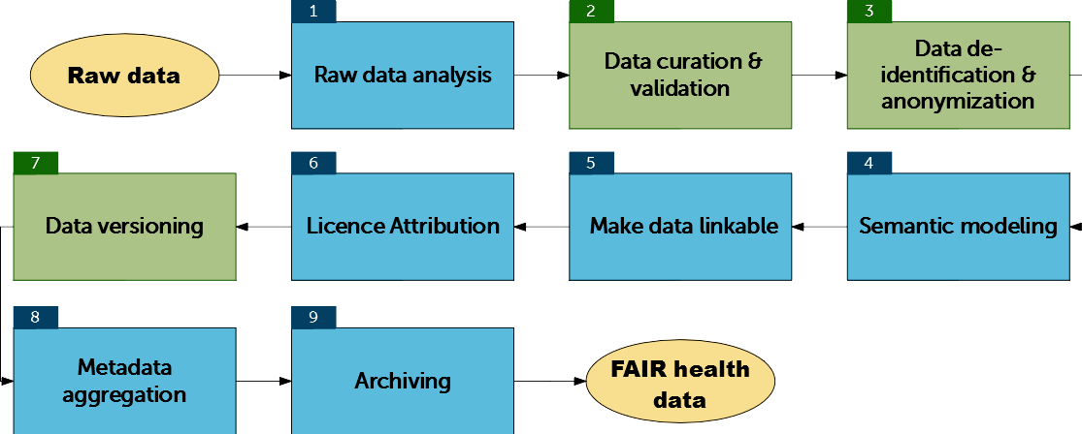
FAIR4Health
Concepts and tools for FAIRification of health data based on HL7 FHIR
Targets:
Support for analyses and AI models on distributed databases
FAIR, normalized data model annotated with medical terminology
Extended GOFAIR workflow
Tools for normalization
https://www.fair4health.eu/en/newsletter

Slide 31



















H2020 projects
Use cases
Mission:
Establishing a pan-European Expert Forum to tackle the complexity of big data integration for in silico methodologies in personalised medicine
Aims:
Assessment of national strategies for data-driven in silico modelling approaches
Development of cross-border standards, recommendations and guidelines for in silico methodologies applied in personalised medicine
BD2DECIDE
SPIDIA4P
SYSCID
Key features:
Harmonisation of health/disease data integration strategies across Europe
Strengthening data-driven in silico approaches
Advise on health data integration and standards for research and industry
Open network that seeks interaction with all relevant stakeholders
LifeCycle
MultipleMS
Standardization
Data and models
Legal/ethical frame
Regulator
Coordinator
www.eu-stands4pm.eu

Slide 32

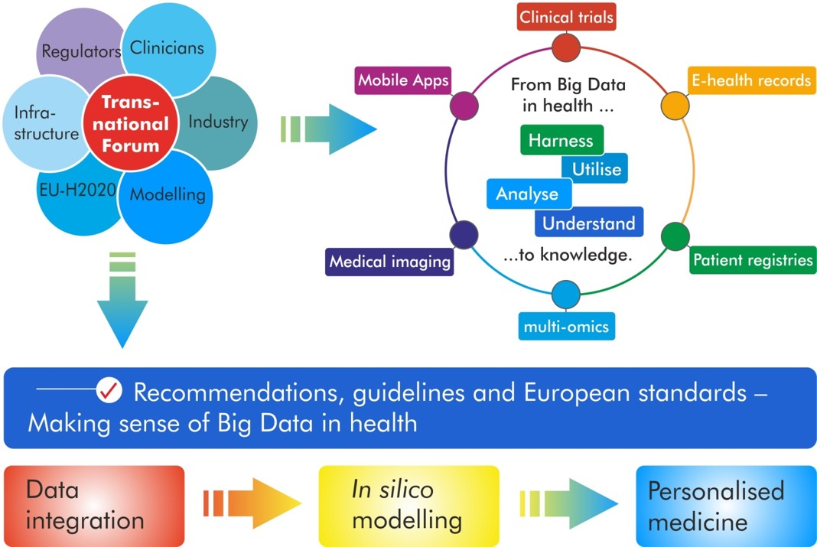
A European standardisation framework to facilitate in silico driven personalised medicine
© EU-STANDS4PM – 2019 │ EU-STANDS4PM is funded by the EC under grant agreement 825843 │ www.eu-stands4pm.eu

Slide 33

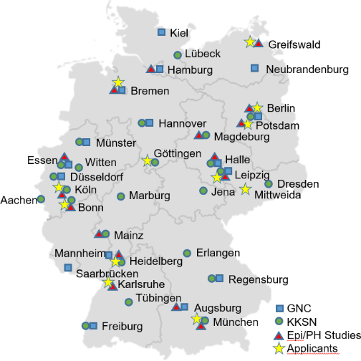
NFDI4Health – Mission and Data
Aims:
Increase the value of research in epidemiology, public health and clinical trial based medicine
Making high quality data internationally accessible according to FAIR principles
Lead to an amalgamation of epidemiology, public health and clinical research
Personal data and metadata from:
Cohorts (GNC)
Clinical trials (KKSN)
Public health surveys (Epi/PH studies)

Slide 34
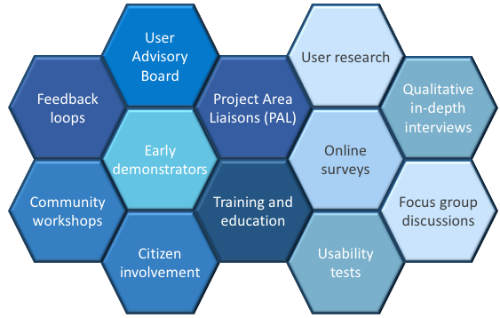
NFDI4Health – Objectives
Findability of and access to structured health data
Federated framework of data holding organisations
Privacy preserving exchange and linkage of personal health data
Automated services (e.g., use and access, analysis tools)
Interoperability and reusability
Use case oriented cooperation between research communities
Business models for sustainability

Slide 35
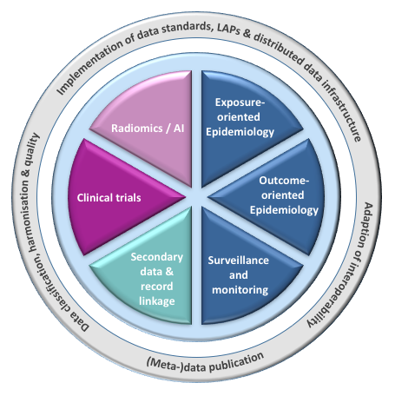

NFDI4Health:
Use Cases
Partner

Slide 36
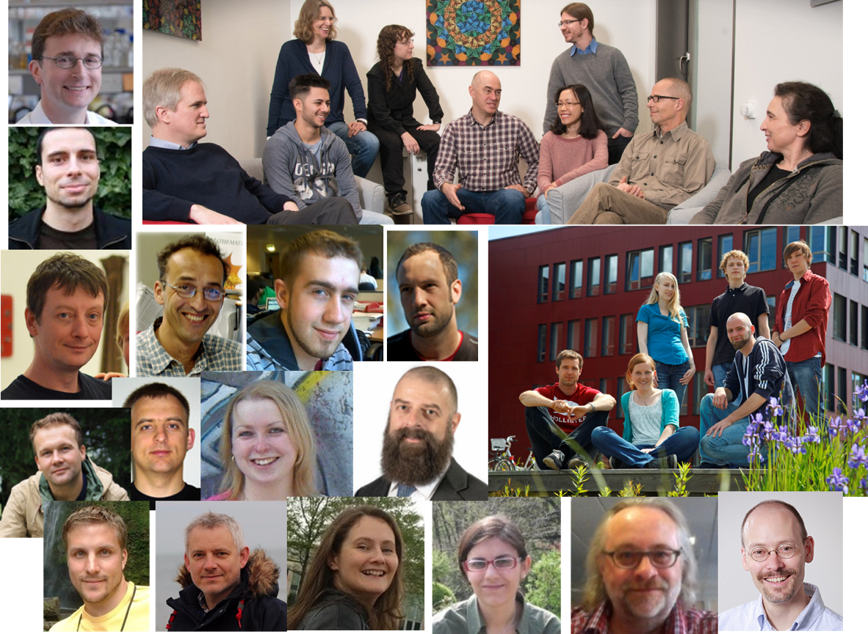




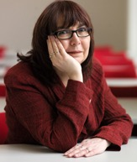
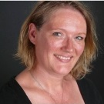
FAIRDOM TEAM

