Slide 1

FAIR and FAIRness: From a community initiative, to implementation via EU law presented by Edit Herczog RDA Council, and FAIR Maturity Model WG Co chair
RDA-DE conference
26th of February 2020

Slide 2
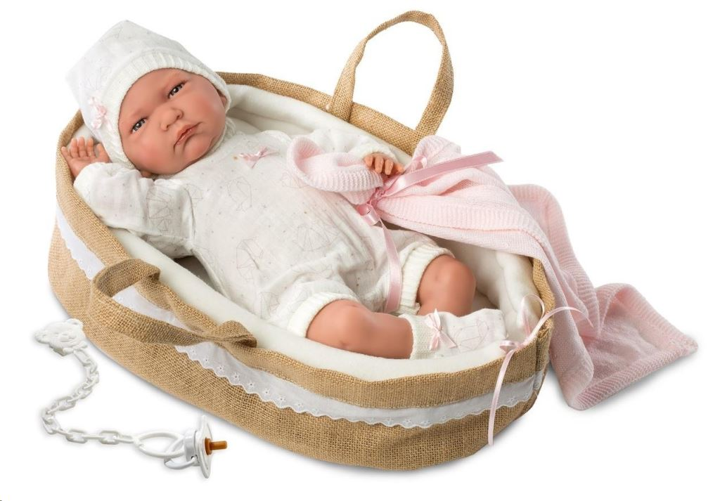
Agenda
The (very) short history of FAIR
2012-2019
The Challenge for Researchers in the 21st century
from Intradomain to Interdomain
The Horizon Europe Programme
The FAIR Added value to the challenges: SDGs
The FAIR Maturity Model Critera
Bottom-up method
Top-down support
The very short future of FAIR
2020 and beyond
The FAIR added value for the EOSC

Slide 3

FAIR as part of the solutions for the challenges a head in the EU

Slide 4
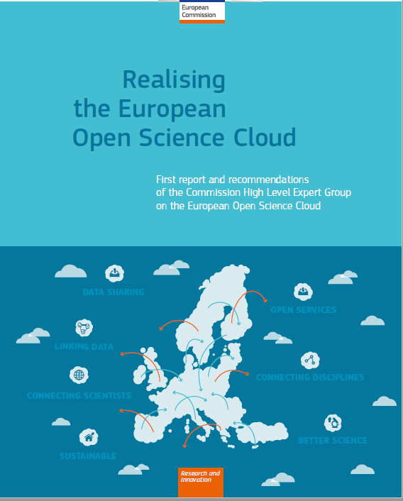
The (very) short history of FAIR
2012:
Force 11: The abreviation FAIR agreed
2016: The EU HLGR on Open Science
FAIR principals arrive to top policy level
2018: FAIR Maturity Model Criteria WG
Already 11 FAIR evaluation methods exist
Half of RDA WGs work on different aspects of FAIR
OPPORTUNITY: FAIR came just in the right time
RISK: Without common understanding and guidelines FAIR will turn to be a hype instead of long term added value for all

Slide 5
The Data Challenge for Researchers in the 21st century
From Intradomain to Interdomain scientific questions
The fast-growing amount of Data from the labs and from the sensors all around „outside the labs” turned the Earth and the Bisophera to living lab, measured in real time
The scientific questions today are often cross-domain and cooperation is a must
Too many data collected too many underused or lost
it coincides with the Capital intensity versus scarcity of resources
The new technologies and new solutions in field of Data should be implemented and expanded

Slide 6
The Horizon Europe Programme 2021-27
Specifically, Horizon Europe will strengthen the Union’s scientific and technological bases in order to help tackle the major global challenges of our time and contribute to achieving the Sustainable Development Goals (SDGs).
At the same time, the programme will boost the Union’s competitiveness, including that of its industries. Horizon Europe will help deliver on the Union’s strategic priorities and support the development and implementation of Union policies.
In a swiftly changing world, Europe’s success increasingly depends on its ability to transform excellent scientific results into innovation that have a real beneficial impact on our economy and quality of life, and create new markets with more skilled jobs.
To achieve this aim and build on the success of its predecessor, Horizon Europe continues to support the whole R&I cycle in an integrated manner.

Slide 7
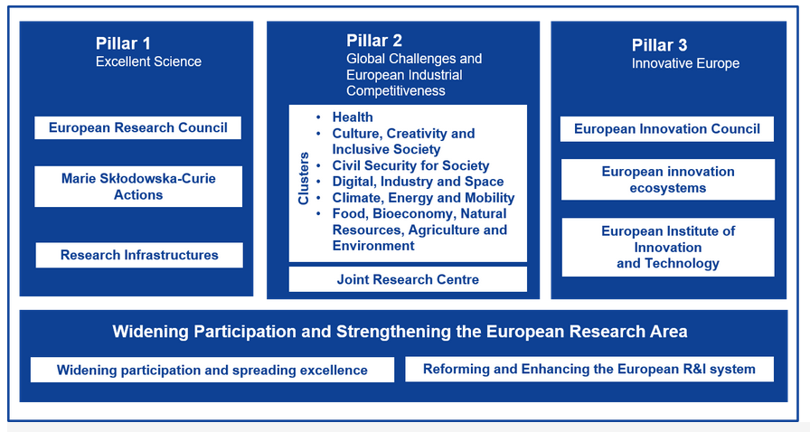
The Horizon Europe Programme 2021-27 Resource are allocated to the pillars

Slide 8

The SDGs: CROSS DOMAIN CHALLENGE
The SDGs implementation: Minimum three goals should be interconnected

Slide 9

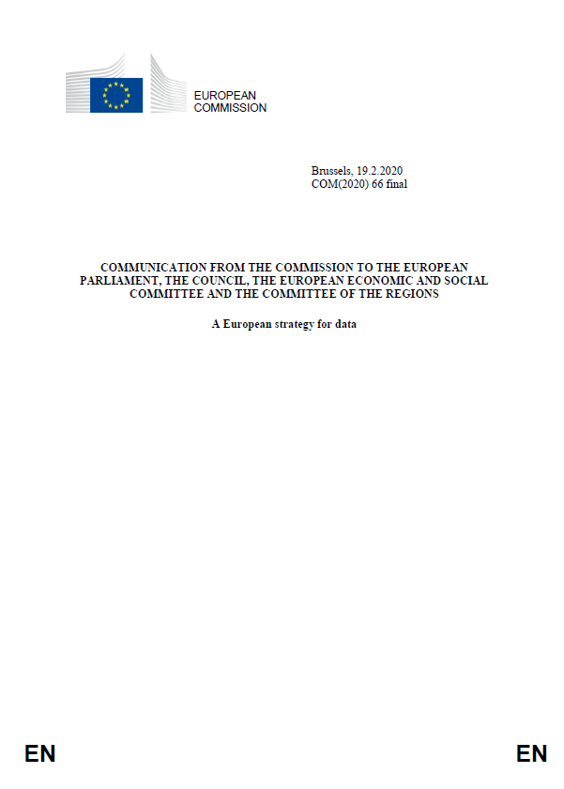

EU Priorities: Council, EC, DG CNECT

Slide 10
HOW TO BE FAIR: From FAIR PRINCIPAL TO FAIR MATURITY MODEL CRITERIA
Introduction of the FAIR Maturity Model WG

Slide 11
Who we are
WG started the WG in January 2019
First plenary session at P13 in Philadelphia
Co chairs:
Keith Russel from Australia
Edit Herczog from Europe
Shelley Stall from USA
Technical Advisory Boards (TAB) member:
Jane Wyngaard from South Africa
Secretariat: Yolanda Meleco from USA
Editorial team: EC special support
Makx Dekkers and the PWC team
129 members: 61 Female, 68 male
We aim to keep the WG 18 months timeline: It would allow to use our recommendation in 2021

Slide 12
Case statement of the WG
Challenge
Ambiguity and wide range of interpretations of FAIRness
Lack of a common set of core assessment criteria and a minimum set of shared guidelines
Approach
Bring together stakeholders
Build on existing approaches and expertise
Intended results
RDA Recommendation of core assessment criteria
Generic and expandable self-assessment model
Self-assessment toolset
FAIR data checklist
Notes:
Objective: explain what this WG is about, i.e. summarize the case statement. Some participants might not have heard about the WG before, we want to trigger their interest.

Slide 13

Case statement of the WG
Target audiences
Researchers, data stewards, other data professionals
Data service owners, e.g. infrastructure, repositories
Organisations that manage research data
Policymakers
Connections
RDA Disciplinary Framework Interest Group
RDA Domain Repositories Interest Group
Other RDA groups
Scope of the assessment
Datasets
Data-related aspects (e.g. algorithms, tools, workflows)
Notes:
Objective: explain what this WG is about, i.e. summarize the case statement. Some participants might not have heard about the WG before, we want to trigger their interest.

Slide 14
Context
The principles are NOT strict
Ambiguity
Wide range of interpretations of FAIRness
Different FAIR Assessment Frameworks
Different metrics
No comparison of results
No benchmark
FAIR
SOLUTION is to bring together stakeholders to build on existing approaches and expertise
Set of core assessment criteria for FAIRness
FAIR data maturity model & toolset
FAIR data checklist
RDA recommendation
Join the RDA Working Group: RDA WG web page | GitHub

Slide 15
Minimum CORE criteria
WHAT
NOT HOW

Slide 16

Scope
BUT the Working Group does NOT have the purpose to ...
develop yet-another-evaluation-method: the core criteria are intended to provide a common ‘language’ across evaluation approaches, not to be applied directly to datasets.
define how the core criteria need to be evaluated. The exact way to evaluate data based on the core criteria is up to the owners of the evaluation approaches, taking into account the requirements of their community
revise and re-design the FAIR principles

Slide 17
WG methodology, timeline & scope

Slide 18
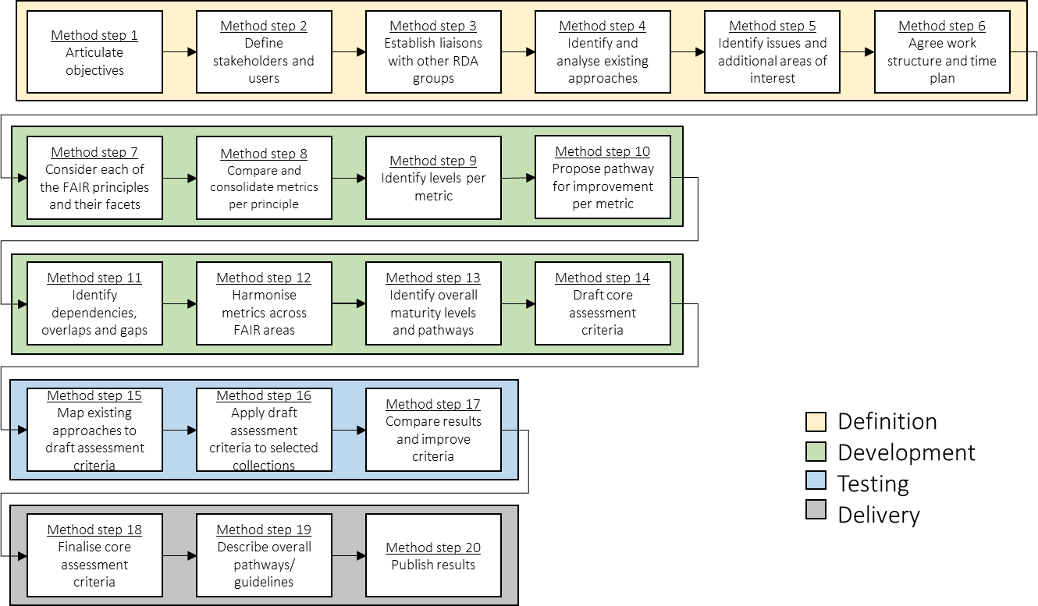
Overview of the methodology
Notes:
Objective: give an impression of the steps we will take, but not discuss in detail every step (the audience can read this afterwards).

Slide 19
Proposed development methodology
Bottom-up approach comprising 4 phases
Definition
Development
Assessment of the four FAIR principles in four ‘strands’
Fifth ‘strand’: beyond the FAIR principles
Testing
Delivery
Notes:
Context: In the development phase, we assess the 4 FAIR facets and possibly elements that fall outside of the facets (“beyond FAIR”).
The approach for this working group consists of 4 phases, further explained on the next slide.

Slide 20
Part I.
Definiton
Proposed Scope

Slide 21
Survey results
Respondents
Big Data Readiness
FAIR Metrics
FAIR evaluator
Data Stewardship Wizard
FAIR data assessment tool
FAIR enough? Checklist to evaluate FAIRness for researchers
Checklist for evaluation of Dataset Fitness for Use
Support your Data
Fairness assessment tools for crediting/rewarding research data sharing activities
Some discussion items derived from the survey
Scope of the assessment
What does the tool assess? [e.g. DMP, dataset, way of conducting research, anything]
Cross-domain or domain-specific?
Audience [e.g. researcher, repository manager, data librarian, data steward]
Automation of the assessment [i.e. what proportion to automate and how]
Certification [e.g. quality label, scoring system]
Maintenance and governance [e.g. GitHub]
Guidance [e.g. checklist]

Slide 22
Summary of open issues after the survay
Scope of the assessment
Data versus metadata, DMP, data sharing activities
General versus domain-specific
Standards maturity
Responsibilities
Criteria definition
Measurement execution
FAIRness literacy
Manual vs automated
Scoring / Levels
Certification

Slide 23
Results of preliminary analysis - 1
Landscaping exercise as a starting point
Analysis of existing approaches
Publicly available documentation and the survey
Clustering questions and options
FAIR facets [e.g. F1, A2] per principle
Beyond the FAIR principles [e.g. data storage]
Identification of potential overlaps
WG to compare questions and derive common aspects

Slide 24
Results of preliminary analysis - 2
So far, 11 approaches are on the radar
 | Approaches considered
 | ANDS-NECTAR-RDS-FAIR data assessment tool DANS-Fairdat DANS-FAIR enough? The CSIRO 5-star Data Rating Tool FAIR Metrics questionnaire Checklist for Evaluation of Dataset Fitness for Use RDA-SHARC Evaluation FAIR evaluator
 | Approach partially considered*
 | Data Stewardship Wizard
 | Approaches not considered*
 | Big Data Readiness Support Your data: A Research Data Management Guide for Researchers
*Methodologies analysed but partially/not included in the results because of questions that could not be classified

Slide 25
Results of preliminary analysis - 3
Early observations
123 questions
5 types of option
4 scoring approaches
On average, six questions per facet
Overlaps and different terminologies used
Some facets are underused [e.g. A1, A1.1, A1.2, A2]
Some facets are overused [e.g. F1, F2]
Different options
YES/NO
TRUE/FALSE
URL
Multiple choice
Free text
Different scoring mechanisms
Stars
Grade
Loading bar
None

Slide 26

Results of preliminary analysis - 4
Five slide decks classifying questions
FAIR – Findable [Link]
FAIR – Accessible [Link]
FAIR – Interoperable [Link]
FAIR – Reusable [Link]
Beyond the FAIR principles (X) [Link]
Questions, options and potential overlaps
Example

Slide 27
Results of preliminary analysis - 5
Beyond the FAIR principles
Characteristics of projects, workflows and tools
Open vs. closed/embargoed data
Curation, maintenance and governance
Certification (what and who/how)
Others ?
Should the WG consider these additional aspects as one or more separate strands?

Slide 28
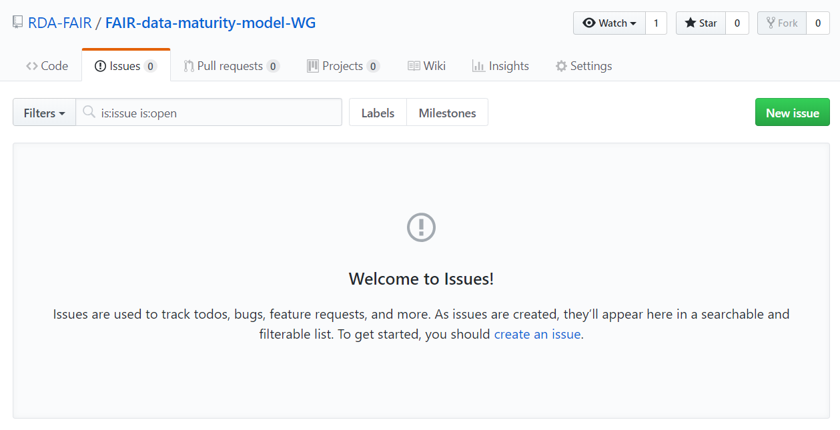
How to contribute - 2
Issue tracking on GitHub (Join GitHub)
Create an issue:
Provide a clear title and a detailed description
Label and categorize the issue [e.g. ]
Methodology
Principle_F

Slide 29
Summary: Proposed scope
 | Proposed resolutions
ENTITY | Dataset and data-related aspects (e.g. algorithms, tools and workflows)
NATURE | Generic assessment (i.e. cross-disciplines)
FORMAT | Manual assessment
TIME | Periodically throughout the lifecycle of the data
RESPONDENT | People with data literacy (e.g. researchers, data librarians, data stewards)
AUDIENCE | Researchers, data stewards, data professionals, data service owners, organisations involved in research data and policy makers
Notes:
During the previous worskshop, these questions came up regarding the scope. The editorial team created github threats to discuss, through no input was received. Therefore, we propose the following resolutions (in line with the case statement).

Slide 30
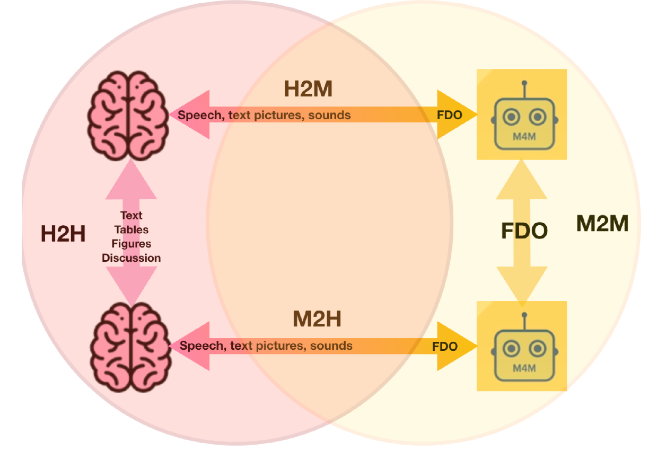
Manual or/and Machine readable
Source: the FDO team
Your speaker is biased and believes we need both instead of fight

Slide 31
Part II.
Development
Proposed criteria

Slide 32

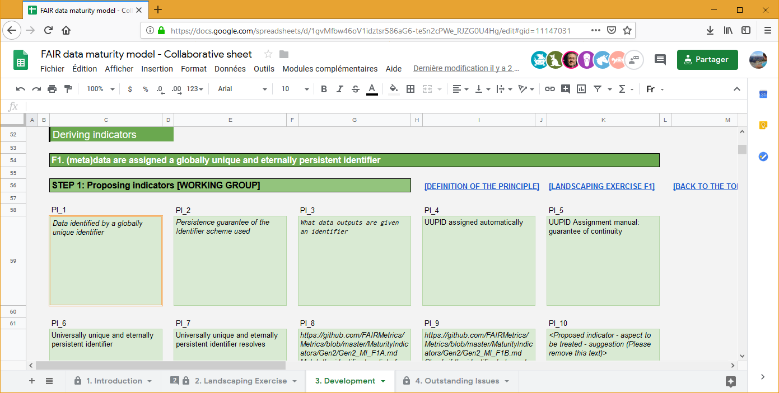
Development | First phase
STEP 1 - INDICATORS
STEP 2 - LEVELS
STEP 3 - CONSOLIDATION
* The indicators and levels later presented are derived from the contributions on the GSheet

Slide 33
Development | Statistics
More concrete contribution for F & A
Most contribution are about metadata
Complex versus simple principles [e.g. 11 indicators for F1 compared to 1 indicator for I3]

Slide 34


Development | Indicators & levels
F1. (meta)data are assigned a globally unique
and eternally persistent identifier
Globally unique
NO globally unique identifier
Globally unique identifier
Persistent
NO persistent identifier
Persistent identifier
Resolve
Identifier does NOT resolve
Identifier resolve

Slide 35
Development | Indicators & levels
F2. data are described with rich metadata
(defined by R1 below)
Metadata
NO metadata
Metadata
Landing Page
NO landing page
Landing page
Providing descriptive information according to a formal metadata standard
NON-standard metadata
Standard metadata

Slide 36
Development | Indicators & levels
F4. (meta)data are registered or indexed in a searchable resource
Harvested by search engine
NOT harvested by a search engine
Harvested by a search engine
Providing metadata to specific portals
Metadata NOT indexed in specific portals
Metadata indexed in specific portals
Institution repositories
(meta)data NOT present in institution repositories
Presence of the (meta)data in institution repositories

Slide 37
Development | Indicators & levels
A1. (meta)data are retrievable by their identifier using a standardised communications protocol
Access conditions
NO access conditions
Access conditions
Manual access
Data retrievable via the researcher
Data retrievable via a repository
Automated access
Data retrievable via human interaction
Data retrievable using a standard client software

Slide 38
Development | Indicators & levels
I2. (meta)data use vocabularies that follow FAIR principles
Standard vocabularies
NO standard vocabularies
Standard vocabularies
FAIR compliant vocabularies
NO FAIR compliant vocabularies
FAIR compliant vocabularies

Slide 39
Development | Indicators & levels
R1. meta(data) are richly described with a plurality of accurate and relevant attributes
Use of guidelines for relevant attributes accompanying metadata
NO guidelines
Guidelines

Slide 40
Overview | Indicators & levels
Under discussion
Provisionally agreed
F |  | F1 (Meta)data are assigned globally unique and persistent identifiers
 |  | F2 Data are described with rich metadata
 |  | F3 Metadata clearly and explicitly include the identifier of the data they describe
 |  | F4 (Meta)data are registered or indexed in a searchable resource
A |  | A1 (Meta)data are retrievable by their identifier using a standardised communication protocol
 |  | A1.1 The protocol is open, free and universally implementable
 |  | A1.2 The protocol allows for an authentication and authorisation where necessary
 |  | A2 Metadata are accessible, even when the data are no longer available
I |  | I1 (Meta)data use a formal, accessible, shared and broadly applicable language for knowledge representation
 |  | I2 (Meta)data use vocabularies that follow the FAIR principles
 |  | I3 (Meta)data include qualified references to other (meta)data
R |  | R1 (Meta)data are richly described with a plurality of accurate and relevant attributes
 |  | R1.1 (Meta)data are released with a clear and accessible data usage license
 |  | R1.2 (Meta)data are associated with detailed provenance
 |  | R1.3 (Meta)data meet domain-relevant community standards

Slide 41
Overview | Indicators & levels
Indicators for Findability
[F1-01M] Metadata is identified by a persistent identifier
[F1-01D] Data is identified by a persistent identifier
[F1-02M] Metadata is identified by a universally unique identifier
[F1-02D] Data is identified by a universally unique identifier
[F2-01M] Sufficient metadata is provided to allow discovery, following domain/discipline-specific metadata standard
[F2-02M] Metadata is provided for the discovery-related elements defined by the RDA Metadata IG, as much as possible and relevant, if no domain/discipline-specific metadata standard is available
[F3-01M] Metadata includes the identifier for the data
[F4-01M] Metadata is offered/published/exposed in such a way that it can be harvested and indexed
FINDABLE
REUSABLE
INTEROPERABLE
ACCESSIBLE
FAIR PRINCIPLES
* The full list of indicators can be found on the following GSheet

Slide 42
Development | Weighting
30
participants
Notable results*
Metadata for discovery > recommended (F2)
Metadata for reuse > mandatory (R1)
(Machine-understandable) knowledge representation > mandatory for metadata & recommended for data (I1)
All references to data > optional (I3)
slido.com #8935
* Results can be accessed here
Notes:
Feedback on GitHub | Survey > report

Slide 43
Development | Weighting Stats
Distribution of the weight of the indicators
Mandatory
Recommended
Optional
FAIR PRINCIPLES
FINDABLE
ACCESSIBLE
INTEROPERABLE
REUSABLE

Slide 44
State of play
Part III.TESTING PHASE

Slide 45
State of play
1. Definition
2. Development
i) First phase
ii) Second phase
3. Testing
4. Delivery
DONE
DONE
DONE
DONE
ONGOING
ON HOLD
* Any comments are still welcomed with regards to the output produced during the first phase | GitHub

Slide 46

State of play
Goal is to finalise indicators and priorities
Indicators and priorities will be further used in their current state
Indicators and priorities will be re-evaluated after the testing phase

Slide 47
Testing phase | Overview
Testing phase
1st level of testing (i.e. comparing indicators against methodologies)
Second run of tests
Feedback integration in the FAIR data maturity model
December 2019
January 2020
February 2020
March 2020
Pilot testing
Early results
Aggreating feeback
Request for changes
General issues

Slide 48
Testing phase |Overview
Thanks to all testers for their contribution
13 volunteers having different affiliations
Various range of disciplines and entities
Different approaches to the scoring
Discipline / Domain
Affiliation / Tool
Tester
Entity
1
Earth Science
NCEI of NOAA
Ge Peng
Dataset
2
Engineering & Technical sciences
4TU.ResearchData
Egbert Gramsbergen, Paula Martinez-Lavanchy, Madeleine de Smaele, Marta Teperek
Dataset
3
Humanities, Spatial, Health, etc.
FAIRsFAIR
Anusuriya Devaraju
Methodology
4
Human-Environment Observatories (OHMs)
DRIIHM infrastructure
Romain David & Emilie Lerigoleur
Methodology
5
Biology
ODAM information system
Romain David & Daniel Jacob
Dataset
6
Agronomic & Biomedical
Agroportal
Romain David, Clément Jonquet & Emma Amdouni
Ontology
7
ALL disciplines / domains
ARDC FAIR self-assessment tool
Kerry Levett & Nichola Burton
Methodology
8
Humanities & Social Sciences
DRI
Kathryn Cassidy & Natalie Harrower
Dataset
9
Astronomy
CDS
Françoise Genova
Dataset
Notes:
Entity: comparison against datasets, methodologies and ontologies.
Type of evaluation: manually
Compliance to the indicators: 5-level scale // Yes&No evaluation
Scoring: average of the 5 levels for each of the FAIR aspects (F,A,I and R) // aggregation per FAIR aspect and priority

Slide 49
Testing insights |Feedback
Comments on indicators
General issues
Specific issues
Information needs
There are (too) many indicators. However, others note that this level of granularity is useful, so you need to think about all the aspects
Testing the indicators provided suggestions for improving existing evaluation approaches or existing standards
Issue about distinguishing indicators for metadata separate from data, which does not work for resources with embedded metadata
Overlap between indicators (e.g. across principles F1/A1 and F2/R1) which is the result of FAIR principles not being entirely independent
Some indicators are conditional, e.g. the ones on authentication, authorisation, references and consent – if not applicable, they should not ‘count’
Several indicators require compliance with community standards, but the question is who defines them?
If data is an ontology, different set of indicators or different priorities may be needed
One tester proposes to do away with all priorities entirely

Slide 50
Testing insights |Feedback
Comments on indicators
General issues
Specific issues
Information needs
FAIR principles are aspirational and ambitious, aiming at full machine-understandability, but current practices are not well aligned at this point in time
Identification is a major issue: there are various comments, some favour identification of metadata over identification of data, others data over metadata, others see both as equally essential, but there is also a comment that having identifiers for both is not common practice
There seems to be a role for landing pages and other human-readable documentation in providing information, in addition to structured metadata
Requests for adding maturity levels > scoring
Data comes in different granularities: whole dataset or part of dataset or individual data items (e.g. observations, concepts)
Different perspectives on metadata and how it relates to data:
repository level / collection level / dataset / data item level metadata
separate metadata records or embedded metadata

Slide 51
Testing insights |Feedback
Comments on indicators
General issues
Specific issues
Information needs
There may be a need to ‘profile’ indicators for specific cases, i.e. selecting a subset of indicators, adapting priorities, following discipline-specific guidelines
Noteworthy that testers are often stricter than the priorities that the WG has defined, e.g. making essential:
machine-understandable community standards
standard, open-source protocols
machine-understandable knowledge representation
standard vocabularies
standard reuse licences

Slide 52
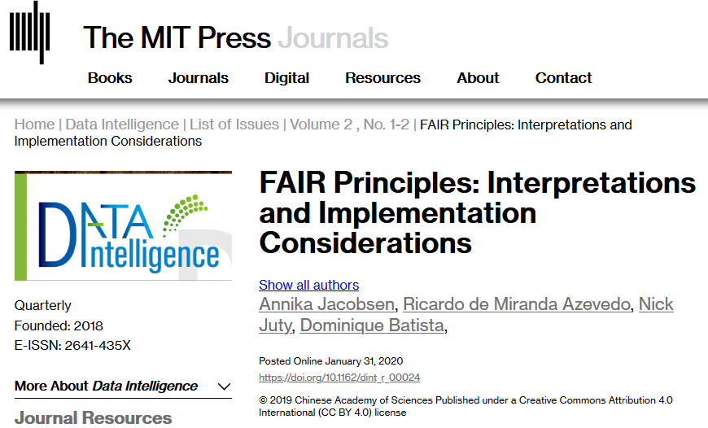
Testing insights |Feedback
Comments on indicators
General issues
Specific issues
Information needs
Need for better explanation of terms, in particular ones that are vague or subjective, e.g. ‘sufficient’
Need for better definition of terms used in FAIR principles, e.g. knowledge representation, FAIR-compliant vocabularies – to take into account https://doi.org/10.1162/dint_r_00024
Need for information on best practices that may be applied to increase FAIRness, e.g. identification, protocols, licences
These issues to be addressed in the Guidelines, using suggestions and examples provide by testers

Slide 53

Scoring mechanism

Slide 54
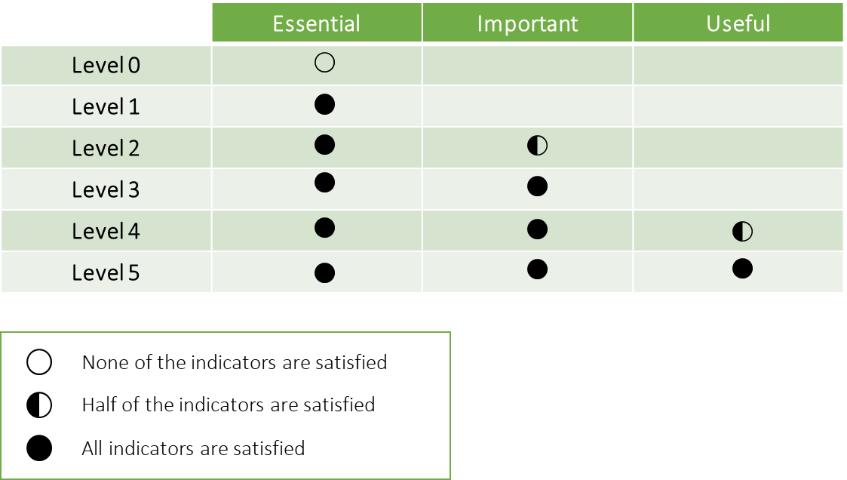

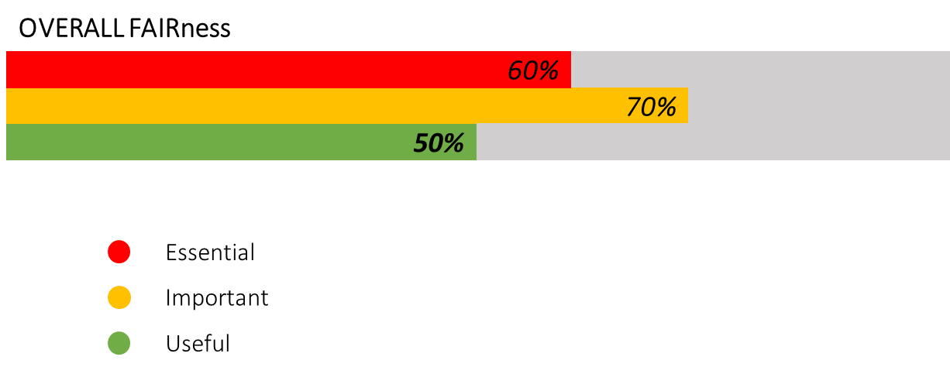
Scoring mechanisms | Overview
5-level scale per indicator
1
2
3
4
5
Five levels of compliance
Per indicator – aggregated per FAIR area
Non applicable or consideration/implementation as options
Useful for giving credit for evolution and helping people to improve
1
2
3
4
5
1
2
3
4
5
FAIRNESS per area
Measurement based on priorities
Per indicator – aggregated per FAIR area
Score determined based on the compliance to priorities
Provides a ‘measure of FAIRness’
Overall FAIRNESS
Measurement based on priorities
Per indicator – overall score
Aggregated score
Provides a quick view of how priorities are met -- but does not give detailed view

Slide 55
Actions items & next steps

Slide 56
Continuity
2020
January | February | March | April | May | June
Testing phase
FAIR data maturity model maintenance (Guidelines, checklist & indicators)
RDA recommendation
End of RDA WG
Workshop
Deliverable

Slide 57
Guidelines | first draft
GUIDELINES | INTRODUCTION | Introduction Objectives Use of the document
 | FRAMEWORK | Indicators Maturity levels Prioritization Indicators description
 | IMPLEMENTATION | How to evaluate

Slide 58




Guidelines | further development
Working Group to share remarks and suggestions about the guidelines
Testing phase will bring out comments and suggestions for change and for additional guidance
Stable version of the guidelines to be published for the next RDA plenary
https://docs.google.com/document/d/1pDGGL3-BbBJu18KlfZUI3AizKLHXGXdIi_mPtpEWmeg/

Slide 59
Action item and next steps
Working Group members are invited to:
Share feedback, comments & suggestions – on the Guidelines
Discuss proposals for changes in priorities on GitHub (issues will be created)
Contribute to GitHub discussion on scoring
We’re also looking for volunteers for further testing; please contact us!
WORKSHOP #8
15th RDA PLENARY IN MELBOURNE
19 March 2020
11.30 – 13h00 (GTM+11) | Breakout 4

Slide 60
Resources
RDA FAIR data maturity model WG
https://www.rd-alliance.org/groups/fair-data-maturity-model-wg
RDA FAIR data maturity model WG – Case Statement
https://www.rd-alliance.org/group/fair-data-maturity-model-wg/case-statement/fair-data-maturity-model-wg-case-statement
RDA FAIR data maturity model WG – GitHub
https://github.com/RDA-FAIR/FAIR-data-maturity-model-WG
RDA FAIR data maturity model WG – Collaborative document
https://docs.google.com/spreadsheets/d/1gvMfbw46oV1idztsr586aG6-teSn2cPWe_RJZG0U4Hg/edit#gid=0
RDA FAIR data maturity model WG – Indicators prioritisation
https://docs.google.com/spreadsheets/d/1mkjElFrTBPBH0QViODexNur0xNGhJqau0zkL4w8RRAw/edit
RDA FAIR data maturity model WG – Indicators prioritisation survey results
https://drive.google.com/open?id=11hyAYCKz_NVoOb9-vlPqjN9LCarOFmc3
RDA FAIR data maturity model WG – Guidelines
https://docs.google.com/document/d/1pDGGL3-BbBJu18KlfZUI3AizKLHXGXdIi_mPtpEWmeg/
RDA FAIR data maturity model WG – Mailing list
fair_maturity@rda-groups.org

Slide 61
The future of FAIR in the EU and EOSC

Slide 62
the EU Data Strategy 2020-24
strengthen the governance mechanisms at EU level and in the Member States relevant for cross-sector data use and for data use in the common sectoral data spaces, involving both private and public players. This could include a mechanism to prioritise standardisation activities36 and to work towards a more harmonised description and overview of datasets, data objects and identifiers to foster data interoperability (i.e. their usability at a technical level37) between sectors and, where relevant, within sectors38. This can be done in line with the principles on Findability, Accessibility, Interoperability and Reusability (FAIR) of data taking into account the developments and decisions of sector-specific authorities; page 12.
For Public Administration: work with Member States to ensure that data sources related to the implementation of the EU budget are Findable, Accessible, Interoperable and Reusable (FAIR). Page 33.

Slide 63
Horizon Europe Programme
The principle of open science will become the modus operandi of the new Programme. It will go beyond the open access policy of Horizon 2020 and require open access to publications and data (with robust opt-outs for the latter), and to research data management plans. The Programme will foster the widespread use of FAIR (findable, accessible, interoperable, and re-usable) data; and activities that enhance researchers’ skills in open science and support reward systems that promote open science. Research integrity and citizen science will play a central role, as will the development of a new generation of research assessment indicators.
More emphasis should in particular be given to the responsible management of research data, which should comply with the FAIR principles of ‘Findability’, ‘Accessibility’, ‘Interoperability’ and ‘Reusability’, notably through the mainstreaming of Data Management Plans. Where appropriate, beneficiaries should make use of the possibilities offered by the European Open Science Cloud and adhere to further open science principles and practices.

Slide 64
Horizon Europe Programme article 10.
Open access and open data
1. Open access to scientific publications resulting from research funded under the Programme shall be ensured in accordance with Article 35(3). Open access to research data shall be ensured in line with the principle 'as open as possible, as closed as necessary'. Open access to other research outputs shall be encouraged.
2. Responsible management of research data shall be ensured in line with the principles ‘Findability’, ‘Accessibility’, ‘Interoperability’ and ‘Reusability’ (FAIR).
3. Open science practices beyond open access to research outputs and responsible management of research data shall be promoted.

Slide 65
EOSC: UVDL speech on 22nd of Januray in Davos
We are creating a European Open Science Cloud now. It is a trusted space for researchers to store their data and to access data from researchers from all other disciplines. We will create a pool of interlinked information, a ‘web of research data'. Every researcher will be able to better use not only their own data, but also those of others. They will thus come to new insights, new findings and new solutions.
This is what we call the European Open Science Cloud and we are the first in the world to do that. It is being developed in Europe for Europe and for European researchers. The idea is that once we have the rules of the game ready, then we will open this up to the broader public sector and to business as well. So that companies can come in, store the data and use the data. And the idea is that it will also open up to international players.

Slide 66
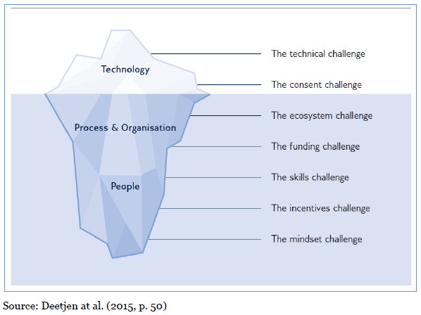
The iceberg is slowly melting

Slide 67
Thank you!

